Slide 1

#OSG Corporate Community Boosters training
How #OSG method can help Corporate Community Boosters in their challenges
Alexandre QUACH, 2021

Slide 2
Course Outline
Since the digital age, (online) communities have flourished and shown the world how much link, content and opportunities it can generate.
In line with Digital, Agile and other cultural transformation, modern corporations also want to leverage the strength of this social way of working for their business and human development.
Among all the ways to build communities, the #OSG method is meant to develop knowledge sharing in organizations by providing mindset, tools, rules and tips in a consistent way and ready to use format.
The current course is meant to understand the underlying challenges that Corporate Community Boosters usually face no matter the method, before delving into #OSG methods concepts, basics and practice.

Slide 3





Part I : Understanding the Challenges before applying the Method
#OSG method is based on accumulated knowledge and real-life experiences of failures and successes in Community Boosting, in companies, public initiatives, non-profit organizations.
If one is to learn the #OSG method, one also must understand the undermining challenges it addresses. Otherwise, it would only be applying a formula in a context without any check on method-context fit. Such approach can be risky and even damaging to your Community.
If the challenges are well understood, #OSG Community Boosters are better prepared to use only relevant elements of the #OSG method, discard some others, upgrade or adapt some others, and even create new elements of methodology to enrich global knowledge about #OSG.
Always use the #OSG method relatively to existing situations, with a strong will to develop further understanding on your own Community, using #OSG or more.

Slide 4
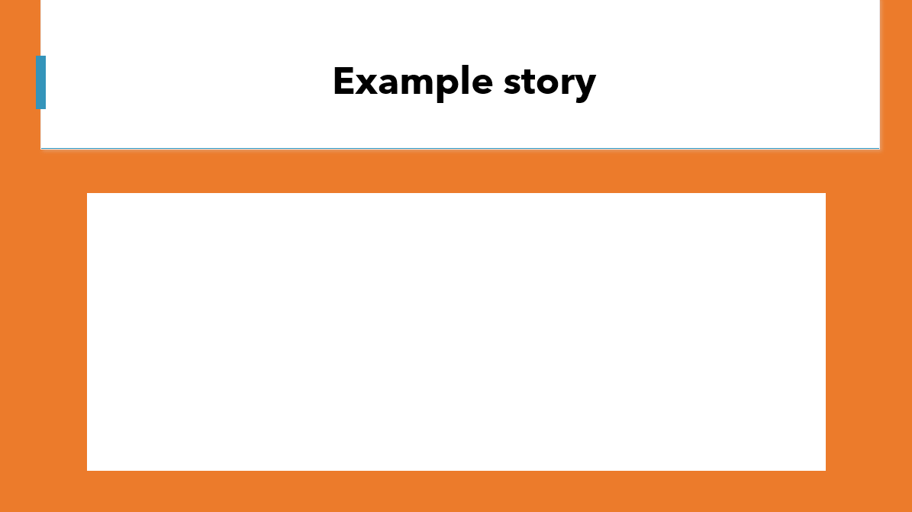
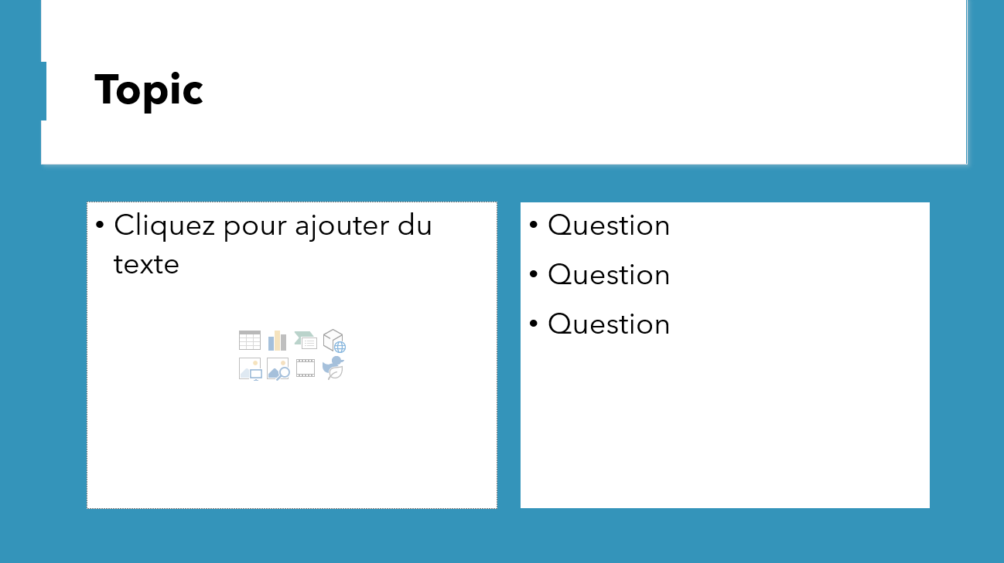
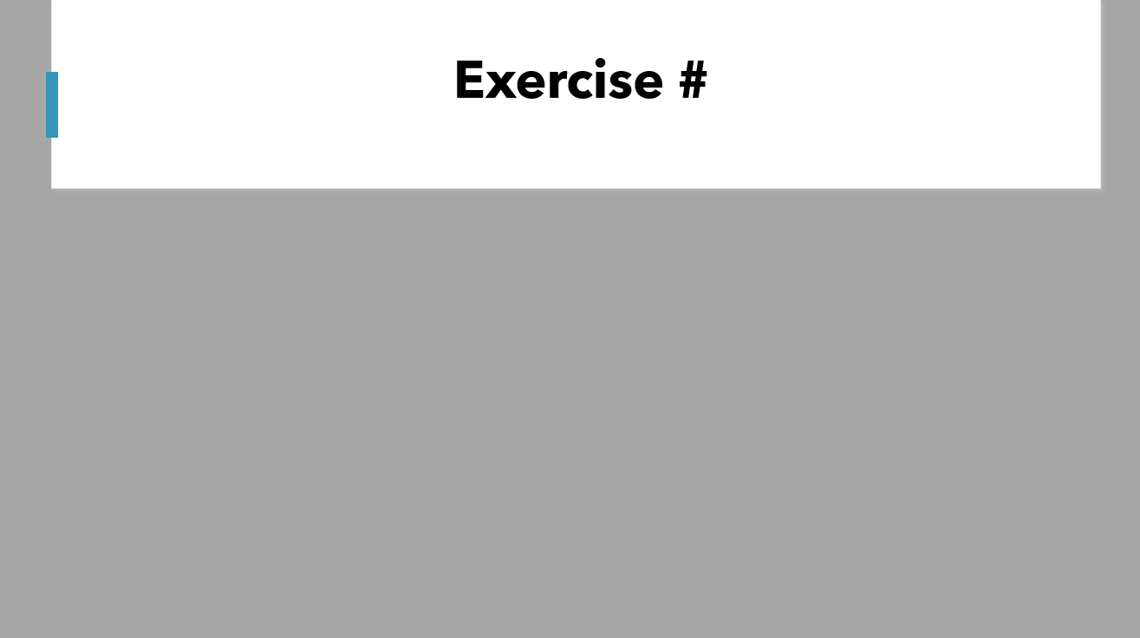
How to read and use this document
This document is tailored for training sessions for Corporate Community Boosters in small groups.
On top of course content (used further in #OSG method), and in order to anchor the knowledge deeper, this presentation also contains :
Example stories / use cases : Most elements in this course will refer to use cases and real-life stories turned into examples (made anonymous in this course).
Interaction moments : The more you interact about a given topic, the higher your chances to anchor the knowledge. You are invited to “stop and discuss” often, instead of just going through all the content in one-shot (which would give the impression to go fast, but can be unproductive on the long term)
Exercises allow you to apply your knowledge to your current corporate community

Slide 5

Part I : Corporate Community Boosters Challenges
Before learning a method, learn what challenges it addresses

Slide 6


Example story
I don’t know where to start,
there are so many topics !
Corporate Community Booster
Notes:
Answer :

Slide 7











Challenge #1 : 360° expectations
Top Management
You must nurture Unity, link, global vision. Therefore, you must integrate with all the job that has already been done and existing structures
Sponsors
Non-sponsoring Hierarchy
You must create transversal involvement in important topics, faster than the usual processes with key objectives.
You must convince managers that the people, members, resources are requested for a valuable reason, show projections and results. Every Quarter.
Value
Content
You must help a wide variety of initiatives to develop within, with and beyond the Community
You must provide interesting content and events for people who already receive lots of notifications and promotion
Non-active members (passive consumers)
Active members
Corporate Community Booster
You must learn to promote your Community without spamming, engaging without forcing, proposing without pressuring…
You must help new members onboard, understand what could be interesting for them, and teach how to get involved
Potential members
New members

Slide 8
Share your opinions and experiences
Do you agree with the list of stakeholders ?
Who are other stakeholders for a Corporate Community Booster ?
What other expectations do you regard as important ?
Top Management
Non-sponsoring Hierarchy
Sponsors
Value
Content
Non-active members (passive consumers)
Active members
Potential members
New members
Notes:
Answer :

Slide 9
Exercise #1 : Write down REAL expectations of your Current corporate Community Stakeholders & identities (real people) as example profiles
Top Management
Non-sponsoring Hierarchy
Sponsors
Value
Content
Non-active members (passive consumers)
Active members
Corporate Community Booster
Potential members
New members

Slide 10

The Content challenges
Content
Since the digital age, Community Boosting and content management have been even more entangled than before.
A community booster is a person who understands the dynamics around content, and a content person can get many benefits in understanding the dynamics of a community.

Slide 11
Example story
I keep sending content, but almost nobody reads it.
I tried pulling out a poll to figure out preferences, but almost nobody reads it.
Corporate Community Booster
Notes:
Answer :

Slide 12






Challenge #C1 Catching attention
Why aren’t the users engaging in my messages ?
46 notifications per day
39 e-mails per day
Attention span < 10 seconds in online videos
46
https://www.businessofapps.com/marketplace/push-notifications/research/push-notifications-statistics/#:~:text=The%20average%20US%20smartphone%20user%20gets%2046%20push,10%25%20of%20users%20to%20disable%20app%20push%20notifications.
https://www.campaignmonitor.com/blog/email-marketing/2019/05/shocking-truth-about-how-many-emails-sent/#:~:text=At%20a%20personal%20level%2C%20DMR%20reports%20show%20that,convey%20some%20form%20of%20value%20to%20the%20recipient.
https://www.arobase.org/actu/chiffres-email.htm#:~:text=Nombre%20de%20mails%20envoy%C3%A9s%20chaque%20jour.%20Monde%20%3A,Internaute.%20Dans%20le%20monde%20%3A%201%2C7%20en%202015

Slide 13
Share your opinions and experiences
How many notifications and e-mails do you receive each day ? On average, how much attention do you pay for it?
How would you describe the evolution over the years ? Did it increase ? Decrease ?
46
Notes:
Answer :

Slide 14


Challenge #C2 Getting a click / a touch
LOOK HERE
IN THIS
THUMBNAIL
Catchy titles
In 14 Minutes, I'll Give You The Truth About Cybersecurity
Cybersecurity - How To Be More Productive?
The Ultimate Guide To Cybersecurity
Instant Solutions To Cybersecurity In Step-By-Step Detail
Cybersecurity: An Incredibly Easy Method That Works For All
7 Ridiculous Rules About Cybersecurity
Poll: How Much Do You Earn From Cybersecurity?
Here's What I Know About Cybersecurity
https://www.nichelaboratory.com/Home/BlogTitleGenerator
Content producers try to intercept the short window of opportunity they have
Examples with “Cybersecurity”
Catchy pictures / thumbnails (with emotional content)
Real full video
3 seconds teaser
Catchy previews (start a short video with “teaser” cuts of the video itself)

Slide 15
Share your opinions and experiences
What other examples of attention catching techniques do you know ? In which platforms ?
What moral issues do you identify in this escalating competition ?
LOOK HERE
IN THIS
THUMBNAIL
Real full video
3 seconds teaser
Notes:
Answer :

Slide 16
Exercise #C2 Brainstorm ideas on how you would get clicks on your Community content
Catchy titles
LOOK HERE
IN THIS
THUMBNAIL
Example :
Everything you need to know about our Community in 5 minutes
Example :
Add John’s image in the thumbnails (people love John)

Slide 17
Challenge #C3 Know how “Catchy” you can be
All the other topics catching the attention of your target
What if I don’t WANT to get into “clickbait-like” strategies ?
The small opportunity you have
What if I don’t have the Skills or resources for such “content packaging” ?
Your target user
What if the topic I want to share about does not fit into such strategy ?
How can I compete ?

Slide 18
Share your opinions and experiences
Do you struggle in getting attention from your target audience ?
On a scale from 1 to 10, how likely it is that you will train in creating catchy content ?
Notes:
Answer :

Slide 19

Example story / Use Case
We manage to get attention from some people, and we even did a small event with them !
But after the event, our tweets did not really work
Corporate Community Booster
Notes:
Answer :

Slide 20



















Challenge #C4 Choose the right content format, balancing scalability and undivided attention
Scalability (easiness of consumption by many people)
Tweet / Short text
Simple picture / Meme
Short video
Infographic
Podcast
Long Video
Article
Online Asynchronous Game*
Live streaming
Online discussion
Online group event
Online Live Game*
Logos represent platforms where you can find examples
Face to face group event
Face-to-face Live Game*
Online
1-1 event
Face to face 1-1
*Game is here defined as a structured moment in which participants are required to be active to advance and in which they get live feedback of their actions. Games can be Serious (with additional objectives, different than catching attention) or not. In this graph, workshop is here counted as a game.
Undivided attention

Slide 21
Exercise #C4 Define or select content format for your Community Content, include next moves
Scalability (easiness of consumption by many people)
Undivided attention

Slide 22
Share your opinions and experiences
Which formats do you use the most in your Community ?
Why did you choose these formats over the others ?
What are your preferences ? In which formats are you currently interested ?
Tweet / Short text
Simple picture / Meme
Short video
Infographic
Podcast
Long Video
Article
Online Asynchronous Game*
Live streaming
Online discussion
Online group event
Online Live Game*
Face to face group event
Face-to-face Live Game*
Online
1-1 event
Face to face 1-1
Notes:
Answer :

Slide 23
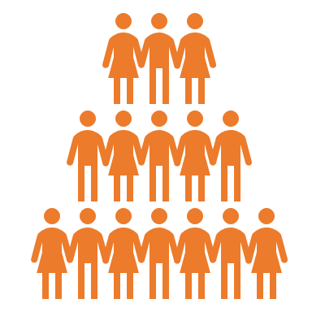






Challenge #C5 Know your next move : Increase Reach or engagement ?
Increase reach :
Target more people
Make more people love our content : increased promotion, attention catching strategies
Make people love our content more : more authenticity, more usefulness, better experience, possibilities to engage
Increase engagement :
Target further engagement

Slide 24
Share your opinions and experiences
With which type of actions are you the most familiar as a Community Booster ? (More people or more engagement ?)
What is your next move ? Why ?
Increase reach :
Target more people
Make more people love our content : increased promotion, attention catching strategies
Make people love our content more : more authenticity, more usefulness, better experience, possibilities to engage
Increase engagement :
Target further engagement
Notes:
Answer :

Slide 25
Exercise #C5 Brainstorm actions for reach or for engagement in your current Community
Increase reach :
Target more people
Write here
Increase engagement :
Target further engagement

Slide 26
Example story / Use Case
We don’t get any reaction from our members; nobody shares our content to their team.
Corporate Community Booster
Notes:
Answer :

Slide 27








Challenge #C6 : Engage audience in your content
Wall 3 :
Join
others
Wall 2 :
Bring the content outside !
1) Attention !
“Look here quick !”
Our content deserves to be opened
2) Activation
“Give a try, it’s easy”
Our content deserves to be consumed (read, listened, watched, played …)
3) Value confirmation
“Give us a rating (or a like!)”
Our content is valuable enough to be validated
4) Contribution
5) Sharing
“Give us your comments !”
“Please share”
Our content is important enough to be discussed (social content is added to the content)
6) Reference
Our content is important enough to be shared
“Feel free to mention”
Our content is valuable enough to be used as a reference in other content
7) Gathering
“Join the others”
Our content is good enough for people to gather by themselves around
Wall 1 :
Identify yourself !

Slide 28
Exercise #C6 : Identify content walls, current stop points
1) Attention !
“Look here quick !”
Our content deserves to be opened
2) Activation
“Give a try, it’s easy”
Our content deserves to be consumed (read, listened, watched, played …)
3) Value confirmation
“Give us a rating (or a like!)”
Our content is valuable enough to be validated
4) Contribution
5) Sharing
“Give us your comments !”
“Please share”
Our content is important enough to be discussed (social content is added to the content)
6) Reference
Our content is important enough to be shared
“Feel free to mention”
Our content is valuable enough to be used as a reference in other content
7) Gathering
“Join the others”
Our content is good enough for people to gather by themselves around
Example : People need to login to give a like
Example wall : No comment engine in our content platform
Example : 30% stop here

Slide 29








Share your opinions and experiences
Usually, on your Community on content, how far do you expect audience to engage ?
What do you currently do for audience engagement in your content ?
In what steps of engagement do you invest the most ? The least ? What do you do ?
Wall 2 :
Bring the content outside !
Wall 3 :
Join
others
Wall 1 :
Identify yourself !
1) Attention !
“Look here quick !”
Our content deserves to be opened
2) Activation
“Give a try, it’s easy”
Our content deserves to be consumed (read, listened, watched, played …)
3) Value confirmation
“Give us a rating (or a like!)”
Our content is valuable enough to be validated
4) Contribution
5) Sharing
“Give us your comments !”
“Please share”
Our content is important enough to be discussed (social content is added to the content)
6) Reference
Our content is important enough to be shared
“Feel free to mention”
Our content is valuable enough to be used as a reference in other content
7) Gathering
“Join the others”
Our content is good enough for people to gather by themselves around
Notes:
Answer :

Slide 30


Use case, example story
I will NOT join your Community now, because there is nobody and nothing interesting for me.
I will NOT join your Community now, because there is nobody and nothing interesting for me.
I will NOT join your Community now, because there is nobody and nothing interesting for me.
I will NOT join your Community now, because there is nobody and nothing interesting for me.
I will NOT join your Community now, because there is nobody and nothing interesting for me.

Slide 31





Challenge #C7 : Understand the Community Desert circle
Not enough people
Content not valuable enough for the corporation
Less motivation and support from corporation
Less capacity for interesting content
Less global interest
Less opportunities to become relevant
Community desert is a vicious circle in which a Corporate Community often begins, and in which it can fall again even after exiting it.

Slide 32
Share your opinions and experiences
Have you experienced the Community desert circle ? What was it like ? How long did you stay in the desert ?
How did you get out of it ?
Not enough people
Content not valuable enough for the corporation
Less motivation and support from corporation
Less capacity for interesting content
Less global interest
Less opportunities to become relevant
Notes:
Answer :

Slide 33

Example story
It takes so much time to create content !
It is so difficult to create something original, especially with all that we can find on the Internet !
Corporate Community Booster
Notes:
Answer :

Slide 34







Challenge #C8 Choose between creating and curating
Content Creation
Content Curation / Collection
Great when content about a topic is rare
Useful against lack of content
Helps user check authentic local content
Differentiation by-design
Slower to produce
Effort : Design, Produce, Publish
Great when content about target topic is already abundant
Useful against Infobesity
Helps user target specific content
Faster to produce
More difficult to use to compete
Effort : Search, Select, Filter, Rate and put together in a same place

Slide 35
Share your opinions and experiences
vs
What style of content generation (creation vs curation) do you generally consume ? Produce ?
What split (% created, % curated) is relevant for your Community ? Why ?
Notes:
Answer :

Slide 36
Exercise #C8 List what you will create and what you will curate
What we will create
Both
What we will curate
Example : Articles about …

Slide 37
The Value challenges
Value
The survival and growth of a Community depends on the value it creates for its members or even for nonmembers.
Value is here defined as instant or delayed positive impacts delivered by activities to members or nonmembers

Slide 38
Share your opinions and experiences
Why is your Community currently valuable for your Corporation ?
Good moments for members?
Good moments for members and nonmembers ?
Business Impacts ?
Indirect Business Impacts ?
Other ?
What are the observable and measurable effects of your Community ?
Value
Notes:
Answer :

Slide 39
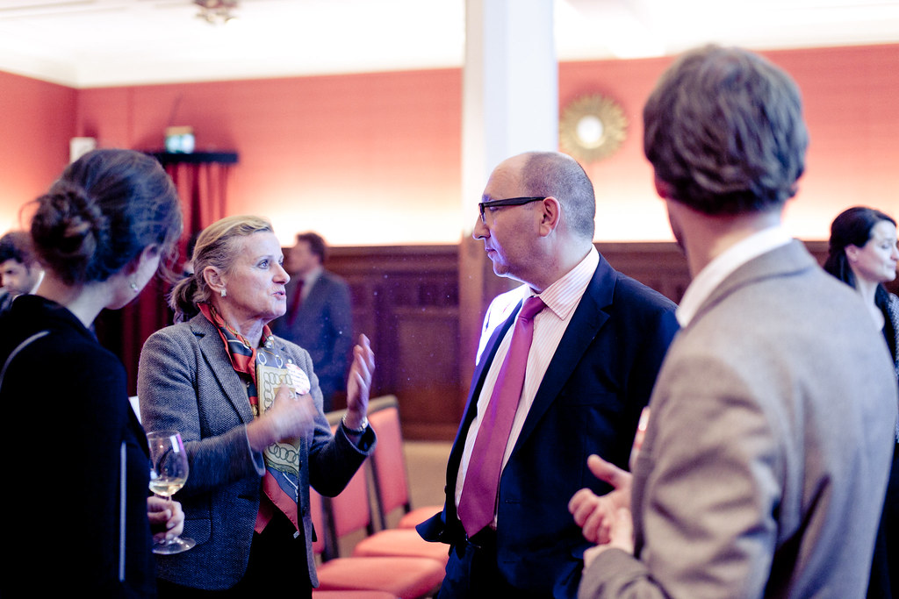

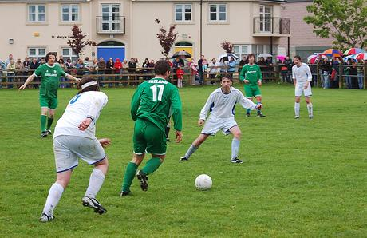

Challenge #V1 Locate the value of your Corporate community
Direct business value
Example : Business opportunity sharing community
Example : Cybersecurity Community
Example : Company’s Football club
Example : Corporate Alumni
Value is mostly for members
Value is for members and nonmembers
Indirect business value

Slide 40
Share your opinions and experiences
With which quadrant are you the most experienced ?
In which quadrants is your Community providing the most value ?
Direct Business value mostly for members
Direct Business value for members and nonmembers
Indirect Business value mostly for members
Indirect Business value for members and nonmembers
Notes:
Answer :

Slide 41
Example story
I have the impression to start all over again, and we have no growth even if we deliver a lot of value
Corporate Community Booster
Notes:
Answer :

Slide 42



Challenge #V2 Exploit Value Momentum
Value Usage
The value produced by a community (positive effects, business benefits, etc.) helps the growth of the Community or its reinforcement
The more value, the higher the chances of growth or reinforcement
Value Momentum
If value is not quickly used for growth or reinforcement, the positive effects forgotten by members and nonmembers. Therefore, momentum will be lost
If value (positive effects) are used for growth, reinforcement, or improvement, momentum is conserved.

Slide 43
Share your opinions and experiences
How familiar are you with managing the momentum ?
How do you usually exploit the positive results of a Community Event ?
Notes:
Answer :

Slide 44
Exercise #V2 Write down how you would exploit the momentum of key value you create
Example
Every time we have a successful event
Send a mail and invite people to join the Community
Ask members to post the picture of them in the event

Slide 45

Example story
The Community grew very fast ! That’s a nice news, but now other communities are accusing us of stealing their audience !
Corporate Community Booster
Notes:
Answer :

Slide 46

Challenge #V3 Manage your borders
Compete
The best way wins or dominates
Integrate
Synergy
Differentiate
A & B end up providing different values to different segments
Market specialization
A & B have different ways to provide the value
A & B merge their powers
When 2 communities provide the same value (for a given activity)
Content Curation, Common events, Common structures & processes
Common governance to define
Co-Define the borders and Co-define the segments. Redirect.
Agree on value segments
If your Community keeps on growing, there are high chances that some of its activities resembles activities of another community, leading to competition, integration or differentiation
Community A
Community B

Slide 47
Share your opinions and experiences
Compete
The best way wins or dominates
Integrate
Synergy
Differentiate
A & B end up providing different values to different segments
Market specialization
A & B have different ways to provide the value
A & B merge their powers
When 2 communities provide the same value (for a given activity)
Content Curation, Common events, Common structures & processes
Common governance to define
Co-Define the borders and Co-define the segments. Redirect.
Agree on value segments
Has your Community ever “competed” with another community ? How did you manage it ?
Have you ever merged or integrated your Community with another ? What did you and why ?
Same questions with differentiation
Notes:
Answer :

Slide 48
Exercise #V3 Identify another Community with which you have borders. Write down your possibilities
Compete
The best way wins or dominates
Integrate
Synergy
Differentiate
A & B end up providing different values to different segments
Market specialization
A & B have different ways to provide the value
A & B merge their powers
Content Curation, Common events, Common structures & processes
Common governance to define
Co-Define the borders and Co-define the segments. Redirect.
Agree on value segments
Our Community
Community B

Slide 49
The Corporate Community Boosters People challenges
Corporate Community Booster is not just a content job, or a value providing job, it is first a people job.

Slide 50
360 expectations - oversimplified
Top Management
Provide value for me !
Non-sponsoring Hierarchy
Sponsors
Provide value for me !
Provide value for me !
Provide value for me !
Provide value for me !
Non-active members (passive consumers)
Active members
Corporate Community Booster
Provide value for me !
Provide value for me !
Potential members
New members

Slide 51
Example story
Members should spend at least 2 hours / week to develop the Community and its benefits, we already invested a lot.
Your Community should foster unity and agreement
Members should not spend more than 1 hour / week because their time is required elsewhere
Top Management
Now what do I do ?
Non-sponsoring Hierarchy
Sponsor
Corporate Community Booster
Notes:
Answer :

Slide 52
Challenge P1 Manage Sponsors & hierarchy expectations
 | Sponsors | Top Management | Non-sponsoring & involved hierarchy
Description Identifying the sponsors and stakeholders can help you at different stages of Community Development | High-powered members in your corporation who provide financial support, resources, legitimacy within the Corporation and decisional acceleration before other high- powered members. They may take responsibilities in your Community and are accountable to Top Management. | Very high-powered members of your Corporation for whom your Community is a new channel for the corporation development. They often look at your Community from far, but sometimes can be key to your Community development | High-powered members in your corporation who oversee the members or potential members of your Community. They are indirectly impacted by your activity, as members under their scope are accountable to them.
Explicit Expectations Expectations that are listed in official statements. Help in your Community legitimacy and management. | Sponsors can help you in making most expectations official and explicit.
Implicit Expectations Untold expectations you guess over time.
Incompatible expectations When Stakeholders do not agree, knowingly or unknowingly. |  | Top management can intervene to arbitrate expectations that are incompatible between themselves.
Common expectations Expectations that are common to several stakeholders. | Building your Community according to these common expectations remove some arbitration cost and delay
Unexpected opportunities & threats Opportunities and threats related to stakeholders, that are not mentioned as expectations but still to be taken into account

Slide 53
Share your opinions and experiences
What are the top expectations of your Sponsoring hierarchy ? Of your non-sponsoring hierarchy ?
Have you ever encountered incompatible or even conflictual expectations ? How did you manage it ?
Top Management
Non-sponsoring & involved hierarchy
Sponsoring hierarchy

Slide 54




Exercise #P1 Identify expectations
Top Management
Non-sponsoring & involved hierarchy
Sponsoring hierarchy
Explicit expectation
Implicit expectation

Slide 55


Use case / Example story
How many members in your Community ?
70
And most of them are active !
250 !!!
But most of them are passive !

Slide 56





Challenge P2 Measure the performance of a Community
Headcount is often used as a measure of a Corporate Community Performance, mostly because headcount is usual when counting other types of groups (companies, customers, …)
However, as most Corporate Communities are part time and not mandatory, level of activity can vary among members from almost nothing (just sign up) to real engagement.
Therefore, as headcount is often unavoidable as a Community performance measurement in Corporation, measurement should be completed with other indicators.
“We do things”
Amount of content (+Content consumption stats)
1
2
3
“People like our things”
Number of positive feedbacks (likes, comments, congratulations, …)
“Things happen”
Event-related indicators (number of events, average attendance, …)
3 communities
Same headcount
Different real activity
Example of indicators

Slide 57
Share your opinions / experiences
What are your Community Performance Indicators ? Do you use headcount ? Why ?
What Indicators would fit your Community the best ?
1
2
3

Slide 58

Exercise #P2 Brainstorm Community performance indicators

Slide 59

Use case / Example story
There is so much to discover in your Community !
I will bring people in !

Slide 60






Challenge P3 Understand your own version of the Golden Engagement Circle
More people
More value for the corporation
More corporate motivation and support
More engagement
More interesting content
More opportunities to be relevant
The Golden Engagement Circle is a state of the Community in which positive impacts trigger each other.
It is often the state Community Boosters want when mentioning “what happens after we reach Critical mass”
The challenge Community Boosters in this state is to amplify (or at least maintain) this circle.

Slide 61




Share your opinions and experiences
Have you experienced the Golden Engagement Circle with your Community ? Describe what happened
How did you maintain it or amplify it ?
More people
More value for the corporation
More corporate motivation and support
More engagement
More interesting content
More opportunities to be relevant
Notes:
Answer :

Slide 62

Use Case / Example story
There is so much you can do with this Community !!!
I don’t have time !

Slide 63






Challenge P4 Identify your members’ Engagement and available time
As Corporate Communities are often a part time activity, most of the members will have to arbitrate their engagement level depending on their specific context.
Challenge for Community Boosters is then to design their community to encourage to engage, considering the context factors.
Arguments to engage in the Community
Value provided by the Community on a professional level
Value provided by the Community on a personal level
Arguments to disengage from the Community
Professional priorities
Logistical constraints
Personal priorities
Logistical convenience of community activities

Slide 64
Share your opinions and experiences
Approximately, how many members are full-time in the Community ? What percentage does it represent ?
How much time do your average members give to your Corporate Community in a month ?
How do you manage various availability of members or potential members ?
Arguments to engage in the Community
Value provided by the Community on a professional level
Value provided by the Community on a personal level
Arguments to disengage from the Community
Professional priorities
Logistical constraints
Personal priorities
Logistical convenience of community activities
Notes:
Answer :

Slide 65
Exercise #P4 List reasons for disengagement and ideas for engagement
Arguments to engage in the Community
Value provided by the Community on a professional level
Value provided by the Community on a personal level
Arguments to disengage from the Community
Professional priorities
Logistical constraints
Personal priorities
Logistical convenience of community activities

Slide 66
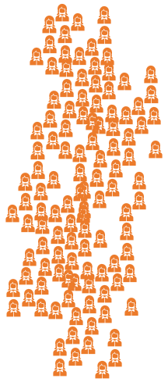

Example story
I like the Community, I can comeback every week for 20 minutes.
Your topic is a part of my life and part of who I am !
I have a lot of time to give
We don’t have much time, at most 2 minutes and very occasionally. But we are legion, and some of us may be interested in more !
Now what do I do ?
Corporate Community Booster
Notes:
Answer :

Slide 67







Challenge P5 Outline members’ time investment profiles
 | 1 | 2 | 3 | 4 | 5 | 6 | 7
 | “You got my attention” | “I want to experience something” | “I want reasons to come again” | “I want to feel involved” | “I want to lead something” | “I want to add my own touch” | “I want to gather people around this topic”
Example of time investment profile (Varies depending in communities and contexts !) | < 5 minutes (or even less) Once Almost by accident | 30 minutes - 1hour Once After being targeted | 30 minutes – 1 hour Occasionally | 30 minutes – 1 hour On a regular basis (even if frequency is low) | >1 hour On a regular basis More often than previous level Also spends “solo” time in Community related activities | Total time >1 hour On a regular basis, solo and collective time. | Various, difficult to define as Community topics become part of the identity of the member.

Slide 68
Share your opinion and experiences
What are the most frequent time investment profiles in your Community ?
What activities are related to these investments ?
 | 1 | 2 | 3 | 4 | 5 | 6 | 7
 | “You got my attention” | “I want to experience something” | “I want reasons to come again” | “I want to feel involved” | “I want to lead something” | “I want to add my own touch” | “I want to gather people around this topic”
Example of time investment profile (Varies depending in communities and contexts !) | < 5 minutes Once | 30 minutes - 1hour Once | 30 minutes – 1 hour Occasionally | 30 minutes – 1 hour On a regular basis (even if frequency is low) | >1 hour On a regular basis More often than previous level Also spends “solo” time in Community related activities | Total time >1 hour On a regular basis, solo and collective time. | Various, difficult to define as Community topics becomes part of the identity of the member.

Slide 69

Use case / Example story
You ask for too much !
It’s too difficult or time-consuming for me !
You don’t have anything difficult enough for me and my ambition ! I was motivated, now I am bored

Slide 70

Challenge P6 Understand Engagement flow
Engagement possibilities
Refusal or Fatigue zone
Flow Zone
Boredom or Frustration
Sense of Belonging
1 | 2 | 3 | 4 | 5 | 6 | 7
“You got my attention” | “I want to experience something” | “I want reasons to come again” | “I want to feel involved” | “I want to lead something” | “I want to add my own touch” | “I want to gather people around this topic”
https://en.wikipedia.org/wiki/Flow_(psychology)

Slide 71
Share your opinions and experiences
Have you ever encountered Refusal/Fatigue Zone when reaching out for your members ?
What about Boredom and Frustration zone ?
Briefly share your stories.
What increases sense of belonging in your Community ?
Engagement possibilities
Refusal or Fatigue zone
Flow Zone
Boredom or Frustration
Sense of Belonging
Notes:
Answer :

Slide 72
Challenge P7 Outline for each Engagement level what are the Gives & Takes
 | 1 | 2 | 3 | 4 | 5 | 6 | 7
 | “You got my attention” | “I want to experience something” | “I want reasons to come again” | “I want to feel involved” | “I want to lead something” | “I want to add my own touch” | “I want to gather people around this topic”
What members are ready to give to the community | ATTENTION | ATTENTION + ENOUGH TIME TO EXPERIMENT | ATTENTION + ENOUGH TIME TO EXPERIMENT + RECURRING ATTENDANCE | ATTENTION + ENOUGH TIME TO EXPERIMENT + RECURRING ATTENDANCE + WILLINGNESS TO CONTRIBUTE | ATTENTION + ENOUGH TIME TO EXPERIMENT + RECURRING ATTENDANCE + WILLINGNESS TO CONTRIBUTE +WILLINGNESS TO TAKE RESPONSIBILITIES | ATTENTION + ENOUGH TIME TO EXPERIMENT + RECURRING ATTENDANCE + WILLING NESS TO CONTRIBUTE +WILLINGNESS TO TAKE RESPONSIBILITIES +WILLINGNESS TO BUILD | ATTENTION + ENOUGH TIME TO EXPERIMENT + RECURRING ATTENDANCE + WILLINGNESS TO CONTRIBUTE +WILLINGNESS TO TAKE RESPONSIBILITIES +WILLINGNESS TO BUILD +WILLINGNESS TO RALLY
What members can possibly expect from the Community | Interesting content | Pleasant experience | - Interest and Utility - Usefulness of community or content experience | - Feeling of being active - Concrete effects resulting from one’s action - Sense of belonging in something bigger Better self-image Alignment of values | Responsibilities Risk of loss and more meaningful success Challenge and opportunity to succeed | - A space to express oneself - Support and tools for creativity - Feeling of being aligned with oneself Posterity Significance | Unattended crowds to conquer Significance Large Vision

Slide 73
Share your opinions and experiences
What do your Community members usually bring to the Community ? To which level is it closer ?
What are the most frequent expectations from your Community Members ?
Notes:
Answer :

Slide 74
Challenge P8 Identify example activities & content for each level
 | 1 | 2 | 3 | 4 | 5 | 6 | 7
 | “You got my attention” | “I want to experience something” | “I want reasons to come again” | “I want to feel involved” | “I want to lead something” | “I want to add my own touch” | “I want to gather people around this topic”
Examples of what a Community can provide for members at each level of Engagement | Social network short posts Tweets Articles Podcasts Pictures Videos | Videos Events Games Serious Games Workshops Books | Tools Advices Products Ready-to-use resources Chat rooms with support | Well-defined tasks Direct effect of one’s effort Moments of togetherness Manifesto to sign & share | Key projects or initiatives currently without leaders Important problems to solve | Space to express oneself (existing media with opportunity of sharing) Audience Matchmaking with followers | New domains to launch Identified potential audience and members A space for proposing new audiences

Slide 75
Share your opinions and experiences
What opportunities or content does your Community provide for members at different levels of engagement ?
In which level have you invested the most ? The least ?
Which levels can your Community address the most easily ? The least ?
Notes:
Answer :

Slide 76
Exercise #P4, 5, 6 Outline engagement levels, then time investment profiles, give & take, activities and content for each level
Engagement level name
Time investment profile
What people are ready to give
What people expect
What your community can provide

Slide 77
Example story / Use Case
What is your Community Engagement target ? What will be the power of the Community by the end of the year ?
Well, um, ….
Corporate Community Booster
Top Management
Notes:
Answer :

Slide 78

Challenge P9 Set up a Community Engagement target Example : The Core & Crowd
“You got my attention” | “I want to experience something” | “I want reasons to come again” | “I want to feel involved” | “I want to lead something” | “I want to add my own touch” | “I want to gather people around this topic”
The Crowd
The core

Slide 79
Challenge P9 Set up a Community Engagement target Example : The closed elite
“You got my attention” | “I want to experience something” | “I want reasons to come again” | “I want to feel involved” | “I want to lead something” | “I want to add my own touch” | “I want to gather people around this topic”
The others
The elite

Slide 80
Challenge 9 Set up a Community Engagement target Example : 3 levels pyramid with Ambassadors
“You got my attention” | “I want to experience something” | “I want reasons to come again” | “I want to feel involved” | “I want to lead something” | “I want to add my own touch” | “I want to gather people around this topic”
Crowd
Ambassadors
The core

Slide 81
Challenge P9 Set up a Community Engagement target Example : The missionaries
“You got my attention” | “I want to experience something” | “I want reasons to come again” | “I want to feel involved” | “I want to lead something” | “I want to add my own touch” | “I want to gather people around this topic”
The self motivating & organizing members

Slide 82
Challenge P9 Represent your Engagement Target (copy paste for numbers)
Target number or %
Target number or %
Target number or %
Target number or %
Target number or %
Target number or %
Target number or %
Level Name
Level Name
Level Name
Level Name
Level Name
Level Name
Level Name
Range Name

Slide 83
Share your opinions and experiences
What are your Community Engagement Targets ?
How far are you from your Engagement Target ?
What is your strategy to reach or maintain your Community Engagement Target ?
What experiences can you share about your Engagement Target ?
“You got my attention” | “I want to experience something” | “I want reasons to come again” | “I want to feel involved” | “I want to lead something” | “I want to add my own touch” | “I want to gather people around this topic”
“You got my attention” | “I want to experience something” | “I want reasons to come again” | “I want to feel involved” | “I want to lead something” | “I want to add my own touch” | “I want to gather people around this topic”
“You got my attention” | “I want to experience something” | “I want reasons to come again” | “I want to feel involved” | “I want to lead something” | “I want to add my own touch” | “I want to gather people around this topic”

Slide 84

Example story / Use case
I’m not ready to Engage more

Slide 85











Challenge P10 Identify Engagement Walls
Engagement Rear Walls (preventing members from engaging less than current level) examples
Ignorance of opportunity : “I did not know it was possible”
Low Estimated pleasure : “I would not enjoy it”
Low Estimated value : “It would not be useful for me”
Guilt : “I would feel guilty to do less”
Lack of resources : “I don’t have the resources to…”
Refusal by others : “Others do not want me to”
Saturation : “there is no more room for this level of engagement”
Irreversibility : “I will not be able to go back”
…
Engagement Front Walls (preventing from engaging more) examples
Ignorance of opportunity : “I did not know it was possible”
Low Estimated pleasure : “I would not enjoy it”
Low Estimated value : “It would not be useful for me”
Lack of legitimacy : “I would not feel legitimate”
Lack of availability : “I cannot invest more time”
Lack of resources : “I don’t have the resources to…”
Lack of skills : “I would not be able to…”
Refusal by others : “Others do not want me to”
Saturation : “there is no more room for this level of engagement”
Irreversibility : “I will not be able to go back”
….
Engagement Rear Walls
are all the reasons why Members do not get less involved
Engagement Front Walls
are all the reasons why Members do not get more involved
Note :
Front Walls can also exist even before level 1

Slide 86
Share your opinions and experiences
What are the rear and front Engagement Walls in your Community ?
Which ones are willfully placed, which ones are unwanted ?
Notes:
Answer :

Slide 87
Challenge P10 Identify your engagement Rear walls
Level Name
Level Name
Level Name
Level Name
Level Name
Level Name
Level Name

Slide 88
Challenge P10 Identify your engagement Front walls
Level Name
Level Name
Level Name
Level Name
Level Name
Level Name
Level Name

Slide 89
Use case
I would really love to get involved more…

Slide 90

Challenge P11 Identify and design Engagement Jumps
Engagement Rear Jumps examples
Demoting : “The decision has been made by others to remove some functions …”
Disappointment : “I invested myself too much and did not get any result”
….
Engagement Front Jumps examples
Acceleration program / Mentoring – Coaching : “I was trained to act further, now I want to act further”
Key decision : “I figured out it was really time to…”
Progressive involvement : “I ended up doing that much, step by step”
…

Slide 91
Share your opinions and experiences
Do you have cases of rear or front Jumps in your Community ?
Which ones were planned, and which ones were unplanned ?
Notes:
Answer :

Slide 92
Challenge P11 Identify ideas for Front Jumps
Level Name
Level Name
Level Name
Level Name
Level Name
Level Name
Level Name

Slide 93
Challenge P11 Identify ideas for Rear Jumps
Level Name
Level Name
Level Name
Level Name
Level Name
Level Name
Level Name

Slide 94
Example Stories
I want to join more community activities because I know cool people doing it !
I’m not really staying for the activities, but mostly for people.
I’m leaving because my friends left
Links and people are not the number one motivation to me, I’m in this community because of the activity

Slide 95


Challenge P12 Look beyond Individual Engagement : Assess the importance of Link
Link, here used as a word for “quality of relationship between two members”, can often (but not always) be mentioned as a key engagement factor in a Community.
Increase, Decrease, or Resilience of an average Engagement level in a Community can be strongly or weakly correlated to link between members.
One additional challenge for Community boosters is to identify how much “link” is important in Community Engagement. This data will help prioritize or design community activities.
Engagement related to content vs engagement related to link

Slide 96
Share your opinions and experiences
What would you say about the importance of links between members in your Community (for your members) ?
How strongly is link correlated to engagement ? What examples do you have ?
Notes:
Answer :

Slide 97
Exercise P12 Identify reasons why Link is not important, and why it is
Link is not important because…
Link is not important because…
Link is not important because…
Link is not important because…
Link is important because…
Link is important because…
Link is important because…

Slide 98



Example Stories
Link cannot be forced with hard tasks or boring talks; it must be natural and emerge through happiness and leisure moments.
Please organize more fun moments !
Link is not built with fun or talks, but mostly through challenging moments that are faced together.
Please organize more collective challenges !
Link is not about actions, whether fun or challenging, but mostly built through values and life goals.
Please organize more moments of expression
Now, what should be the next activity ?
Corporate Community Booster

Slide 99

Challenge P13 Choose how you define “Link”
There are many ways to define “Link” in a Community. The definition is often difficult to measure and can vary among members.
The Community Boosters are responsible for choosing and organizing activities in the Community. Therefore, the definition of “Link” by Community Boosters will drive the type of Link that is fostered in the Community.
In Communities where link is important and strongly related to engagement level, the type of link that is fostered has higher chances to engage members sharing the same definition, than members who define “link” differently.
Here is an example of one way to define link, using a scale of Friendship quality that identified 4 dimensions : Safety, Help, Closeness and Acceptance.
To what extent are members attached to their friend(s) (among members)
To what extent are members’ confidence and trusts relied on his or her friend(s) (among members).
The extent to which members will offer their mutual help to their friend(s) (among other members) who are having Community-related problems.
To what extent are members accepted by their friend (among members) either socially or emotionally.
Source Study: Friendship Quality Scale: Conceptualization, Development and Validation https://files.eric.ed.gov/fulltext/ED542465.pdf

Slide 100
Share your opinions and experiences
How do you define “link” between members in your Community ?
What “link creating” actions have you organized or fostered in your Community ?
To what extent are members attached to their friend(s) (among members)
To what extent are members’ confidence and trusts relied on his or her friend(s) (among members).
The extent to which members will offer their mutual help to their friend(s) (among other members) who are having Community-related problems.
To what extent are members accepted by their friend (among members) either socially or emotionally.
Notes:
Answer :

Slide 101



Exercise P13 Define what type of Links you want to foster, and key activities you prioritize
Link in our community means…
Therefore, we will focus more on …
Example : Sharing emotions and problems
Example : Co-development sessions

Slide 102






Example story
So, how’s the community building up ?
Any clues on the tightness of the collective ?
I’m glad about what has been achieved with the Community.
You must feel proud, don’t you ?
Members are divided and the Community is scattering, you must do something !
Well…
Corporate Community Booster

Slide 103

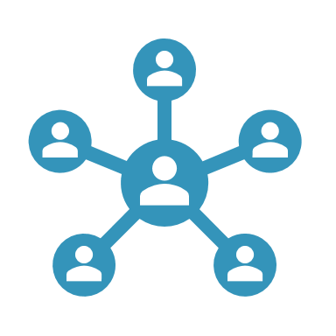







Challenge P14 Measure Link
Gathering data about level of link can be challenging for Community boosters. Here is a short list of usual difficulties :
Declarative bias
Difficulty to frame questions and measurement procedure about link
Difficulty to get the information frequently from all members
Difficulty to gather and interpret weak signals
Unclear legal or ethical limits of Privacy
Depending on what tools are available for Community Boosters, measuring link with real data can become a major challenge. Here are some examples of ways and indicators on link measurement :
Social network platform: Number of “connections” within the Community per member
Chat tools : Frequency of discussion, Diversity and average involvement of chatters, “Depth” of discussions
Event management tools : Number of times an average member meets the same people in event
Polls : Answers on various questions about links
“Feeling” and interpretation by Community Boosters or by Key members of the Community

Slide 104
Exercise P14 Define how you will measure Link
We will measure link in our community with the following indicators …

Slide 105
Share your opinions and experiences
Do you measure link in your Community ? How ?
What are your difficulties ? What indicators have you used ?
Notes:
Answer :

Slide 106

Example story
We have more and more people, which is good. We look like we have more capacity, but people don’t get as much involved as before.

Slide 107



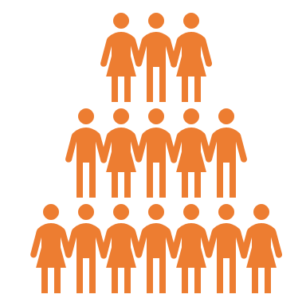


Challenge P15 Understand how link, Numbers and Engagement work together (or not !)
The lower the number of members in a Community, the higher the chances for members to be linked to each other through accumulated direct interactions.
The higher the number, the lower the “average link to members” (if not compensated).
This variation can cause various damageable effects or increase existing effects like Ringelmann effect (decrease of engagement relatively to group size), or like loss of sense of Belonging.
Engagement level can also sometimes increase with additional members, as more members can increase trust, and unlocks more economies of scale and therefore to more potential of actions.
Reading more :
https://en.wikipedia.org/wiki/Dunbar%27s_number
https://en.wikipedia.org/wiki/Ringelmann_effect
Average engagement 80%* Max engagement
Average engagement 100%* Max engagement
Average engagement 40%* Max engagement
Average engagement 60%* Max engagement
*Example numbers to represent Ringelmann effect, not actual numbers ! (will depend on context)
Every level of critical mass unlocks new opportunities thanks to economies of scales

Slide 108
Share your opinions and experiences
Did you witness your Community grow in Numbers ?
Have you observed any effects on engagement when it grew in numbers ?
What strategies have you developed to compensate negative effects, or to amplify positive effects of growing on engagement ?
Notes:
Answer :

Slide 109

Example story
The Community used to feel like a family, now it became unpersonal.
On top of that, some of my friends have left. I don’t know anybody now, and I am less motivated than before.

Slide 110






Challenge P16 Build Link through common identity
As number of members increases, feeling of closeness and link can decrease.
To decrease the time for two members to feel related to each other, Community Boosters can choose to build a common culture, which facilitates interaction by creating references and trust.
This Community identity can be anchored in Artifacts.
Community Booster must balance the cost of learning the culture (which increases the entry and onboarding cost to the Community), the interest of setting up culture for engagement.
Community Boosters must also decide about the organic generation of culture (fostering, directing, slowing it).
https://en.wikipedia.org/wiki/Sapiens:_A_Brief_History_of_Humankind
Example of Community artifacts :
Community Manifesto
Community Charter
Name of the Community & Common name for Community Members
Community values
Community Mascot or fictional characters representing community identity
Community common story telling

Slide 111
Share your opinions and experiences
What are your Community Artifacts ?
In which order have you defined them ?
How does it help your members ? How does it hinder new entrants ?
Notes:
Answer :

Slide 112
Exercise P16 Choose your artefacts and display them on a timeline
WHAT :
We will define / co-create the following artifacts
Example : Community Charter
WHEN:
These artifact will be used when…
Example :
When we reach 50

Slide 113
Example Stories
All Community links depend on me, I’m the only one keeping people together.

Slide 114




Challenge P17 Identify patterns in your Link architecture
Example patterns
Core & Followers pattern: Most members are not linked to each other; a very small core of the community is followed by a throng of followers. This pattern is closer to Fan Communities of Content providers (Youtubers, Streamers, Influencers…).
Pyramid pattern : Members are linked only to a small group of other members, among which a local group leader, who is in turn linked to other group leaders in another small group, etc. This pattern is closer to some large companies, providing strong local link with the cost of broader sense of belonging.
Fabric pattern : Members are all linked to other members in local small groups, but groups are interwoven so that access no member can really prevent access to other members. This pattern is closer to business networks.
Link architecture is an overview of how links are distributed in your Community (between which members).
Link Architectures evolve over time and can be represented with approximate patterns.
Patterns can be used to define a target Link architecture and a link building strategy by Community Boosters

Slide 115
Share your opinions and experiences
What is the current pattern of links in your Community ?
Do you have a target link architecture ? What is it ? Why ?
Notes:
Answer :

Slide 116

Example Story
I must stay connected with too many people at the same time !
I cannot handle it anymore

Slide 117
















Challenge P18 Limit of links for an individual
Number of links
Any individual has a limited capacity to handle a high number of relationships, no matter how high the limit can specifically be.
When numbers of link exceed key thresholds, which are specific to each person in his/her own context, the general quality of the link decreases.
Depending on the importance of Link in your community, such decrease can be damaging for your Community.
When targeting a specific pattern, or even managing a Community Booster activity, one should consider this effect.
Mistakes, blunder or worse in responses
Only formal moments
Inability to empathize
Link Fatigue
Shorter, less content-rich, less personal responses
Informal moments with shortlist of closest members only
Loss of Empathy and loss of quality of listening
Efforts, but not sustainable on the long run
Respond to messages thoroughly
Informal moments with other members
Careful listening, Empathy
Sustainable effort in relationships

Slide 118
Share your opinions / experiences
Have your ever reached your own limits of link ?
What happened ? How did you manage the situation ?
Mistakes, blunder or worse in responses
Only formal moments
Inability to empathize
Link Fatigue
Shorter, less content-rich, less personal responses
Informal moments with shortlist of closest members only
Loss of Empathy and loss of quality of listening
Efforts, but not sustainable on the long run
Respond to messages thoroughly
Informal moments with other members
Careful listening, Empathy
Sustainable effort in relationships

Slide 119


Example Story
It is simple, togetherness goes up at every yearly celebration and goes down in between !

Slide 120






Challenge P19 Identify link dynamics
Links in your Community depends on many factors, not only Community Boosters targets. Link building strategies must include various forces that influence the link dynamics, among which :
External recurring events : National Holidays, Festivals
Internal recurring events : Community Birthday, Community ritual
External spot (happening once) events : Competition, call for help, people leaving and entering the corporation …
Internal spot (happening once) events : Celebrations, Conflicts, …
Link culture : average tendency to link to other members, acceptance of link among peers
Key members activities : Parties, clubs, …
Challenge of Community Boosters is to consider these internal and external forces when deciding the next course of action and designing next events.
It is up the Corporate Community Boosters to identify opportunities for link building and threats of link collapsing.

Slide 121
Share your opinions and experiences
On top of your strategy and Community Boosting actions, what factors influenced the Links in your Community ?
How did you adjust your strategy to these factors ?
External recurring events
Internal recurring events
External spot (happening once) events
Internal spot (happening once) events
Link culture
Key members activities
Notes:
Answer :

Slide 122






Exercise P19 Identify elements that will influence Link in your Community Identify how you will exploit or compensate them
WHAT will increase Link no matter what we do as Community Boosters
Example : Christmas holidays
Example : Organize a Christmas party
HOW we can exploit this positive influence
HOW we can compensate the negative influence
Example : Mix teams from the two conflictual managers
WHAT will decrease Link no matter what we do as Community Boosters
Example :
Recent Conflict between managers

Slide 123
Use case / Example Story
Now all the power is mine !!!

Slide 124





Challenge P20 Embrace Community Booster Ethics
With massive and growing power over attention, content, value, engagement and link, comes related responsibilities. Community Boosting ethics can involve many personal and collective topics, including :
Privacy Concerns
Conflicts of interests
Boundaries between personal and professional links
Free-will vs engagement mechanics
Group thinking
Exclusion effects due a to strong Community identity
These questions should be studied and considered by Community Boosters, from trainees to experts

Slide 125
Share your opinions and experiences
As a Corporate Community Booster, What ethical topics are the most important to you ?
What actions do you do at your level about these topics ?

Slide 126
Exercise P20 Identify ethical questions and propose answers
Ethical question
Example : How will we manage privacy ?
Example :
Idea : allow all users to delete their account, remind them
Example :
Use nicknames instead of real names
Solution

Slide 127
End of Course
Summary
Take-aways
Limits of the models
Exercises
Going further

Slide 128
Summary
Corporate Community Boosting encompasses many functions, including managing value, content and people.
There is a strong competition in catching attention. Such condition invites CCBs to select the right format according to scalability or undivided attention, balance actions between reach strategy and engagement strategy, and select when to curate and when to create.
A community must deliver value, and it is better done when target value is identified, when value momentum is exploited, and when value delivery is made compatible with whatever already exists in the Corporation, like other communities.
As far as people are concerned, CCBs must manage the stakeholders' expectations. One target for resilient growth is to set up a Golden Engagement virtuous circle, which requires understanding of engagement pros and cons for Community Members. Levels of engagement can be outlined, in order to better understand members’ time investment profiles, expectations and propose the right level of opportunities to everyone, keeping them in the Engagement flow. These levels of engagement also help in defining a Community Engagement target and help in clarifying what blocks or accelerate Engagement dynamics (walls and jumps).
Engagement level can also depend on the level of link between members, which can be defined using various dimensions, measured, and fostered, especially when members become numerous. Link architecture and dynamics are also to be considered when deciding a strategy.
The power given to Community Boosters comes with responsibilities, and Community Booster should consider ethical questions about their activities.

Slide 129
Take-aways
Frames of reference:
7 levels of engagement in content
7 levels of engagement
Concepts
Community Desert Circle
Community Engagement Target
Engagement Walls
Engagement Jumps
Other
Key stories and examples
Value-Content-People
Golden Engagement Circle
Value Momentum
Engagement flow
Link Definition, architecture, Community Artifacts

Slide 130
Summary : List of Corporate Community Challenges 1/2
Value Challenges
Content Challenges
Catch attention in a noisy environment
Locate the value of your Corporate Community
Exploit value momentum
Manage your Community Borders
Get a click / touch
Know how catchy you can be
Choose the right content format, balancing scalability and undivided attention
Know your next move
Engage audience in your content
Understand the Community Desert Circle
Choose between creating and curating

Slide 131

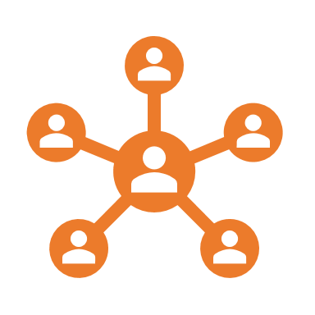

Summary List of Corporate Community Challenges 2/2
People Link Challenges
Other Challenges
Identify Link dynamics
Assess the importance of Link
Figure out 360 expectations
Understand the limits of links for an individual
Choose how you define Link
Measure Link
Understand how link, numbers and engagement work together (or not!)
Identify Patterns in your link architecture
Embrace Community Boosters Ethics
People Engagement Challenges
Manage sponsors & hierarchy expectations
Measure your Community performance
Understand your own version of the Golden Engagement Circle
Identify members’ Engagement and available time
Outline members’ time investment profiles
Understand Engagement Flow
Outline for each Engagement level what are the Gives & Takes
Identify example activities & content for each level
Set up a Community Engagement Target
Identify Engagement Walls
Identify and design Engagement Jumps

Slide 132
Limits
Every course, every model, no matter how powerful and adaptive, has its limits. It is important for learners to identify some unanswered questions, some assumptions that could be challenged, some development paths.
We hope that listing a first set of limits of this course will encourage learners to keep being curious, to keep upgrading the course, and keep learning beyond.
Short and non exhaustive list of interesting, yet unanswered, questions
How to manage User Generated Content ? How to manage conflicting expectations ? How to create sub-communities or join a super community ? How to balance sense of belonging, loss of involvement ? How to manage Community organic generation of culture ?
Short and non exhaustive list of assumptions that could be challenged
Communities rely on content Engagement follows the interpretative framework of reference “7 levels” Engagement persists Catching attention is difficult Engagement can be broken down into pieces and put in a linear model
Short and non exhaustive list of further development paths for this course
Frame of reference for Engagement Walls and Jumps

Slide 133

Exercises
Tackle with your Community Booster Challenges now !

Slide 134
Exercise #1 : Write down REAL expectations of your Current corporate Community Stakeholders & identities (real people) as example profiles
Top Management
Non-sponsoring Hierarchy
Sponsors
Value
Content
Non-active members (passive consumers)
Active members
Corporate Community Booster
Potential members
New members

Slide 135
Exercise #C2 Brainstorm ideas on how you would get clicks on your Community content
Catchy titles
LOOK HERE
IN THIS
THUMBNAIL
Example :
Everything you need to know about our Community in 5 minutes
Example :
Add John’s image in the thumbnails (people love John)

Slide 136
Exercise #C4 Define or select content format for your Community Content, include next moves
Scalability (easiness of consumption by many people)
Undivided attention

Slide 137
Exercise #C5 Brainstorm actions for reach or for engagement in your current Community
Increase reach :
Target more people
Increase engagement :
Target further engagement

Slide 138
Exercise #C6 : Identify content walls, current stop points
1) Attention !
“Look here quick !”
Our content deserves to be opened
2) Activation
“Give a try, it’s easy”
Our content deserves to be consumed (read, listened, watched, played …)
3) Value confirmation
“Give us a rating (or a like!)”
Our content is valuable enough to be validated
4) Contribution
5) Sharing
“Give us your comments !”
“Please share”
Our content is important enough to be discussed (social content is added to the content)
6) Reference
Our content is important enough to be shared
“Feel free to mention”
Our content is valuable enough to be used as a reference in other content
7) Gathering
“Join the others”
Our content is good enough for people to gather by themselves around
Example : People need to login to give a like
Example wall : No comment engine in our content platform
Example : 30% stop here

Slide 139
Exercise #C8 List what you will create and what you will curate
What we will create
Both
What we will curate
Example : Articles about …

Slide 140
Exercise #V1 Locate the value of your Corporate community Write down your Community activities in each quadrant
Direct business value
Example : Business opportunity sharing community
Example : Cybersecurity Community
Example : Company’s Football club
Example : Corporate Alumni
Value is mostly for members
Value is for members and nonmembers
Indirect business value

Slide 141
Exercise #V2 Write down how you would exploit the momentum of key value you create
Example
Every time we have a successful event
Send a mail and invite people to join the Community
Ask members to post the picture of them in the event

Slide 142
Exercise #V3 Identify another Community with which you have borders. Write down your possibilities
Compete
The best way wins or dominates
Integrate
Synergy
Differentiate
A & B end up providing different values to different segments
Market specialization
A & B have different ways to provide the value
A & B merge their powers
Content Curation, Common events, Common structures & processes
Common governance to define
Co-Define the borders and Co-define the segments. Redirect.
Agree on value segments
Our Community
Community B

Slide 143
Exercise #P1 Identify expectations
Top Management
Non-sponsoring & involved hierarchy
Sponsoring hierarchy
Explicit expectation
Implicit expectation

Slide 144
Exercise #P2 Brainstorm Community performance indicators

Slide 145
Exercise #P4 List reasons for disengagement and ideas for engagement
Arguments to engage in the Community
Value provided by the Community on a professional level
Value provided by the Community on a personal level
Arguments to disengage from the Community
Professional priorities
Logistical constraints
Personal priorities
Logistical convenience of community activities

Slide 146
Exercise #P4, 5, 6 Outline engagement levels, then time investment profiles, give & take, activities and content for each level
Engagement level name
Time investment profile
What people are ready to give
What people expect
What your community can provide

Slide 147
Exercise P9 Represent your Engagement Target (copy paste for numbers)
Target number or %
Target number or %
Target number or %
Target number or %
Target number or %
Target number or %
Target number or %
“You got my attention” | “I want to experience something” | “I want reasons to come again” | “I want to feel involved” | “I want to lead something” | “I want to add my own touch” | “I want to gather people around this topic”
Range Name

Slide 148
Exercise P10 Identify your engagement Rear walls
Level Name
Level Name
Level Name
Level Name
Level Name
Level Name
Level Name

Slide 149
Exercise P10 Identify your engagement Front walls
Level Name
Level Name
Level Name
Level Name
Level Name
Level Name
Level Name

Slide 150
Exercise P11 Identify ideas for Front Jumps
Level Name
Level Name
Level Name
Level Name
Level Name
Level Name
Level Name

Slide 151
Exercise P11 Identify ideas for Rear Jumps
Level Name
Level Name
Level Name
Level Name
Level Name
Level Name
Level Name

Slide 152
Exercise P12 Identify reasons why Link is not important, and why it is
Link is not important because…
Link is not important because…
Link is not important because…
Link is not important because…
Link is important because…
Link is important because…
Link is important because…

Slide 153
Exercise P13 Define what type of Links you want to foster, and key activities you prioritize
Link in our community means…
Therefore, we will focus more on …
Example : Sharing emotions and problems
Example : Co-development sessions

Slide 154
Exercise P14 Define how you will measure Link
We will measure link in our community with the following indicators …

Slide 155
Challenge P16 Choose your artefacts and display them on a timeline
WHAT :
We will define / co-create the following artifacts
Example : Community Charter
WHEN:
These artifact will be used when…
Example :
When we reach 50

Slide 156
Exercise P19 Identify elements that will influence Link in your Community Identify how you will exploit or compensate them
WHAT will increase Link no matter what we do as Community Boosters
Example : Christmas holidays
Example : Organize a Christmas party
HOW we can exploit this positive influence
HOW we can compensate the negative influence
Example : Mix teams from the two conflictual managers
WHAT will decrease Link no matter what we do as Community Boosters
Example :
Recent Conflict between managers

Slide 157
Exercise P20 Identify ethical questions and propose answers
Ethical question
Example : How will we manage privacy ?
Example :
Idea : allow all users to delete their account, remind them
Example :
Use nicknames instead of real names
Solution

Slide 158

Going further
To infinity and beyond current knowledge and know-how

Slide 159
Going Further
Other courses
Viral Transformation Concepts : Understanding the Viral approach to learning and knowledge sharing
#OSG Method Basics : Overview of the #OSG method
Setting up #OSG method in your Community in 10 steps : How to Start #OSG for your Community !

Slide 160

Viral Transformation Concepts
Course pitch and content summary
Viral transformation is a new way of thinking large scale education and formal training. Discovers what are the big ideas, inspirations and concepts that you can adapt afterwards in your organization.
What is Viral Transformation ?
Why foster Viral Transformation ?
How do we foster Viral Transformation ?
Models & Examples
Factors of Viral Transformation

Slide 161
#OSG Method for Viral Learning in your Community
Develop knowledge sharing in communities

Slide 162
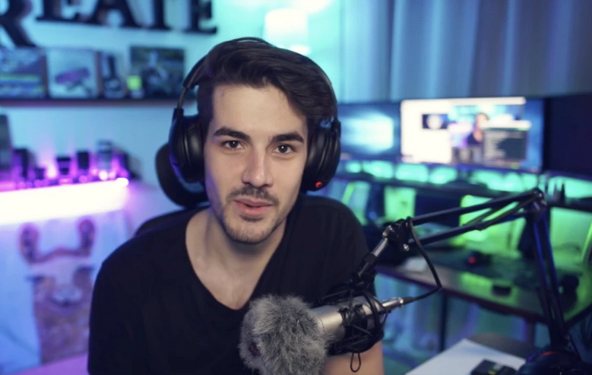
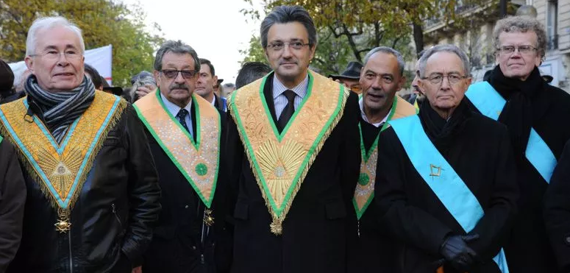
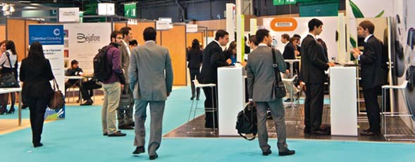
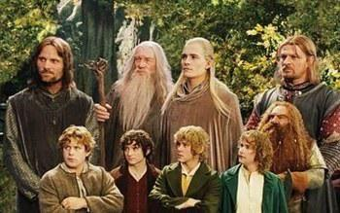
The many realities behind ONE word : Community
Social media-like Community
Corporation-like community
Business Network like community
Small circle of experts like Community

Slide 163
Corporate Community
Community parameters :
Community Objectives & Purposes
Number of members
Membership rules
Community Content topic
Community Content format
Importance of Link
Type of link
Level of Link
Link architecture
Engagement levels
Engagement targets
….
What type of Communities are Corporate Communities ?

Slide 164






Challenges of Corporate Communities
Engagement
We do 90% of the job
Excitement of novelty
Understanding the upkeep cost & effort
We are here only because there was free food
Launch
Routine and boredom
How to trigger natural growth (more members, more content) or retention ?
Time
How to increase average ENGAGEMENT and avoid 2-speeds community ?
How to make engagement last ?

Slide 165
Why #OSG for Learning in your Community ?

Slide 166
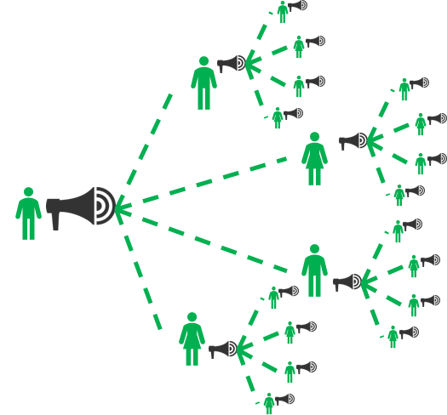
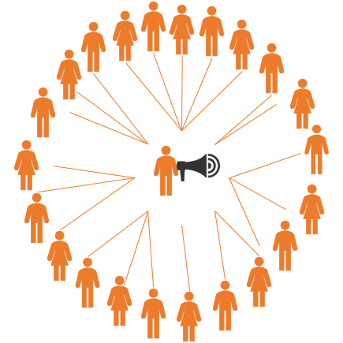




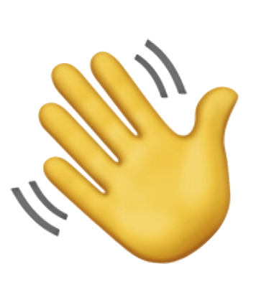
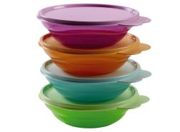
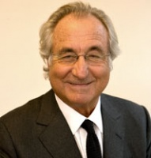
Broadcast vs Viral pattern
Broadcast pattern :
1 emitter
N-1 unrelated receivers
Centrally controlled messages
Viral Pattern :
One, then more and more emitters
Few then more and more related receivers
Distributed messages
Find this type of communities on products like :
Target Attention profile :
Find this type of communities with products like :
Target Attention profile :

Slide 167
Broadcast vs Viral
Broadcast pattern
Viral Pattern
🎯Challenges :
Competition for attention
Reach the largest possible audience
Regular production
💡Usual tactics:
Catch attention at all costs
One size fits all and good message-audience fit
Mass events and communication (mailing, etc.)
Like and Subscribe
🎯Challenges :
Unwillingness to share (fear, lack of legitimacy, difficult logistics)
Unidentified sharers
Risk of Message variation
Forgetfulness
💡Usual tactics:
“Bring your friend”
Sharing made easy
User empowerment
Anchor the message for as long as possible
Message Adaptiveness (to fit the various parts of the graph)

Slide 168
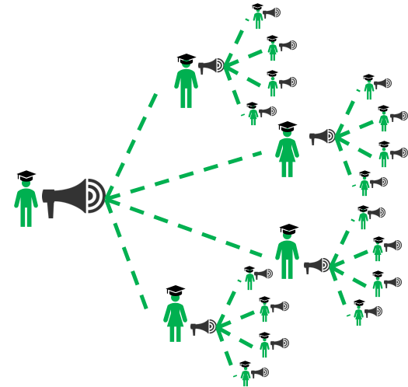
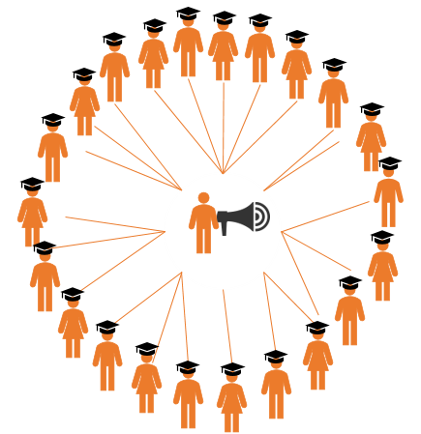
Broadcast Learning vs Viral Learning
👍Advantages :
Speed
Content Consistency
Low marginal cost
🛠️Usual Tools :
LMS
Articles
Videos
Lectures
Digital Serious Games
🛠️Usual tools:
Workshops
Events
Live Serious Games
Peer-to-peer
Mentoring
👍Advantages :
Empowerment
Social Link between Learners and Sharers
Knowledge Resilience
Adaptiveness

Slide 169



#OpenSeriousFilters NOT all type Content fit viral learning
Better fit for broadcast learning
Better fit for Viral Learning
Tacit Knowledge
Personal experiences
Testimonials
Context-related Short Stories
Tips and Tricks
Best Practices
Explicit knowledge : Rules, Frameworks
Structured methods
Standardized frames of reference

Slide 170








CONTENT Conditions for Viral Learning
??????
Virus content must be COMPATIBLE with the TYPE OF LINK within the Community.
Eg : Professional content in a professional community
Virus content must be VALUABLE enough to be shared.
If the content is not valuable, Virus will be rejected and will stop its spreading
Virus content must be SMALL enough to be memorized and spread with at least the SAME level of QUALITY

Slide 171






Set-up a Value Selection, Improvement and Promotion process
Amélioration de la forme
Promotion de la satisfaction sur la forme
Amélioration du fond
Promotion de l’utilité du fond
Transmetteurs
Présentation
Transmission
Mesure de satisfaction de la forme
Mesure de l’utilité
Retour d’expérience après mise en application
Mise en application
Appropriation
Public
Retransmission
Promotion
GOAL :
Virus content must be VALUABLE enough to be shared.
If the content is not valuable, Virus will be rejected and will stop its spreading

Slide 172
Split your content into small, shareable, easily remembered bits
Shorter sessions
Clear Rules
Clear expected outcomes
More participative formats
Do not try to spread Deep content virally (risk of information loss)
??????
Virus content must be SMALL enough to be memorized and spread with at least the SAME level of QUALITY

Slide 173


Create Link inside your Community
Set up Small Tables (<10 persons) within the Community
Matchmake people together
Avoid link dilution (split the community if necessary)
LINK must be possible between target members.
If the learners do not have the capacity or the will to meet and share, spreading will stop.

Slide 174


Breaking the “I don’t have time” wall
I don’t have time for curiosity
This knowledge can save my time
Filter content by
time-saving capability
I don’t have Time
It is easy and fast to learn
I don’t have the energy to learn
Filter content by
easiness to learn
Sharing the content will make my life better
I am too tired to share
Integrate incentives to share

Slide 175



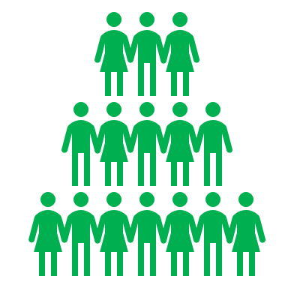


Foster or reuse motivations to share
Link creating or fostering
Skills improvement
“Why would you share knowledge ?”
Social Reward / Recognition
Pleasure of sharing
Sense of collective Duty
Sense of Meaning
External advantages

Slide 176



Example : Scale for Engagement by available time
“I will definitely be a regular member”
➔ CREATE AN EVENT AND MORE !
“I will be a regular member”
➔ CO-HOST AN EVENT !
“I have an hour from time to time”
➔ ATTEND EVENTS !
“I might be available one hour right now”
➔ START A DISCUSSION
“I have a few minutes from time to time”
➔ POST CONTENT !
You can help by personally forwarding a recent community content to specific people around you. Believe us : personal invites make a big difference
You are not the only one sharing the same level availability, and most of us will enjoy snacking cybersecurity content you might share on our social network.
No matter if you are curious, amateur or expert, there is probably a question you can ask the community or an answer you can provide to existing questions. Check out the forums !
You can attend an event of the Cybersecurity community and bring colleagues in. We are always happy to welcome new members knowledge and skills.
As a regular member, people get to know you and you get to know people. Co-hosting is can go from simple welcoming to questions answers or even co-creating the content.
The Cybersecurity community is on constant building and growth, there are many things to design together for Thales.
“I happen to have 2 minutes just now”
➔ FORWARD CONTENT

Slide 177







PEOPLE Conditions for Viral Learning
LINK must be possible between target members.
If the learners do not have the capacity or the will to meet and share, spreading will stop.
Members must develop enough SKILL to spread the viral content.
Necessary skill increases with virus SIZE.
Members must feel LEGITIMATE enough to spread the viral content

Slide 178


Viral Community effect : how we can all contribute to weave the network
Replay events in your own team
Community events
I saw a presentation in the Cybersecurity Community, and asked the speaker to do it again for our team
Community People
Let’s go together to this Cybersecurity event
Bring your teams in Community Events
My team organizes an event, and the community may be interested in attending
Multiply the impact of your own events by bringing the community in

Slide 179


Viral Community effect : how we can all contribute to weave the network
Community Content
Hey Jacques, here is an article I found in the cybersecurity community
Share relevant Community content specifically
Hey Community, here is a content about Cybersecurity that might interest you
Share relevant content to the Community

Slide 180



Viral Community effect : how we can all contribute to weave the network
Community People
I met someone in the Community who might interest you
You might interest someone of the community
Matchmake people you meet in the community
Matchmake people you meet outside the community

Slide 181
Viral Community effect : how we can all contribute to weave the network
Community events
Community Content
Community People

Slide 182



Workshop 1 : #OpenSeriousHub A share and learn opportunities workshop
What is this workshop about ?
Since the CdW, we now have an overview of topics of our community.
Let’s get into more details to pick out those who can be turned into real life events where we can meet, share and learn !
The goal of this workshop put in common to know :
On which topics each of us can share
Which topics are the most popular
Which topics can be organized “on popular demand”
Who among us can share about this popular demand
What inputs do we bring in the 1st part of the workshop ?
What discussions will happen on the 2nd part of the workshop ?
What will be the outcomes of the workshop ?
I can help you on the TOPIC 3 topic !
Ideas for Major events in case of popular demand
It looks like lots of you are interested in my presentation, maybe I should plan a meetup then
Topics on which I can share my knowledge and experience
Topics I want to learn
Appointments adjusted to availabilities
TOPIC 3
I’m only available one-hour on the next month
TOPIC 1
Let’s just have a team coffee with you then
My team and I would be interested in learning about TOPIC 2
TOPIC 4
TOPIC 2
Link between people sharing same interests AND non attendants
Next time, I will bring some colleagues in !
My team will be happy with whom I found today !

Slide 183
Workshop 2 : Topics mapping A workshop to find out what fits best for you
What is this workshop about ?
Our community is about Cybersecurity, which is a wide and general topic. Our mission now is to choose the best topics for upcoming events. This workshop is made to classify topics and cast light on topics :
For which we make the most of our skill and experience
That we like the most
That are the most valuable for Thales
What inputs do we bring in the workshop ?
A list of key topics of the community
What will we do in the 1st part of the workshop ?
Ranking the topics on 3 dimensions (enjoyment, skills, value for Thales), marking the top 20% of each
What will be the outcomes of the workshop ?
A map of the most valuable topics from which we can create events and content.
MANAGING SECURITY TECH DEBT IN LEGACY SYSTEMS
Ranking by
💗 🛠️ 🏠
💗The topics we like the most
🏠The topics with the most business impact
🛠️The topics in which we are the most skilled
PRACTICAL APPLICATIONS OF THE CYBER ENGINEERING POLICY
PRACTICAL APPLICATIONS OF THE CYBER ENGINEERING POLICY
SOCIAL ENGINEERING LATEST NEWS
PRIVACY REGULATIONS 2022
-----
-----
-----
-----
Top 20%
PENTESTS
OPTIMIZATION
PRACTICAL APPLICATIONS OF THE CYBER ENGINEERING POLICY
PRACTICAL APPLICATIONS OF THE CYBER ENGINEERING POLICY
-----
-----
-----
-----
PRIVACY REGULATIONS 2022
-----
-----
PRIVACY REGULATIONS 2022
MANAGING SECURITY TECH DEBT IN LEGACY SYSTEMS
MANAGING SECURITY TECH DEBT IN LEGACY SYSTEMS
-----
-----
PENTESTS
OPTIMIZATION
SOCIAL ENGINEERING LATEST NEWS
PENTESTS
OPTIMIZATION
PENTESTS
OPTIMIZATION
-----
-----
MANAGING SECURITY TECH DEBT IN LEGACY SYSTEMS
-----
-----
-----
-----
SOCIAL ENGINEERING LATEST NEWS
PRIVACY REGULATIONS 2022
SOCIAL ENGINEERING LATEST NEWS
…
Example Data
Best topics zone, with the highest chances of success

Slide 184
Tips for Community Boosting

Slide 185

#OSG Method Basics
Course pitch and content summary
The #OSG Method is a framework to help Communities grow in numbers, engagement, by developing their knowledge sharing power, using Viral learning as a mindset and Engagement levels as a backbone. Discover the big ideas behind the method used in large, small, profit and non-profit organizations for their Communities development.
History and goal of #OSG Method
Value-focused stories, ideas and tools
People-focused stories, ideas and tools
Content-focused stories, ideas and tools

Slide 186

Setting up #OSG in 5 steps
Course pitch and content summary
#OSG method is made to be implemented, practiced, applied, learned and understood. This course help you set up #OSG method for your Community in 5 easy steps
Overview : Framing what you want first,
Value : Set up value targeting process , improvement process, promotion processes
Members : Defining, promoting, and following up #OpenSeriousPath
Content : Increase the range, easiness to share, and lasting power of your content
Further development : Foster virtuous circles, Keep on innovating

Slide 187





The #OSG Method Goals
Create and Persist Community engagement through knowledge sharing
Progressively Change Learners posture from passive to active, from receivers to knowledge sharers
Track and foster Viral Learning & knowledge sharing

Slide 188









The #OSG principles
Set up roles for each community topic
Set up calendar
Promote and incentivize knowledge sharing
More learners become knowledge sharers
Community content becomes easier to share
Knowledge sharing has more value for the host organization
Split, select and prioritize content for viral learning
Set up tracks
Gather content into “viral learning ready” data base
Set up value improvement loop
Set up value promotion loop

Slide 189












The #OSG Role System Viral Learning by design
I boost members into upper levels
I create content, variations
I share knowledge
I help in knowledge sharing
LEVEL 1 CURIOUS
LEVEL 2 PLAYERS
LEVEL 3 SCOUTS
LEVEL 4 CO-HOST
LEVEL 5 HOST
LEVEL 6 CREATOR
LEVEL 7 CONTENT COMMUNITY BOOSTER
I promote
I try
I’m interested
Gamifying Empowerment in the Community with clear roles and levels for all.
Each role represents a further engagement level and supports the growth of lower levels.

Slide 190
The #OSG Role System Viral Learning by design
I’m interested
I try
I promote
I help in knowledge sharing
I share knowledge
I create content, variations
I boost members into upper levels
LEVEL 1 CURIOUS
LEVEL 2 PLAYERS
LEVEL 3 SCOUTS
LEVEL 4 CO-HOST
LEVEL 5 HOST
LEVEL 6 CREATOR
LEVEL 7 CONTENT COMMUNITY BOOSTER

Slide 191
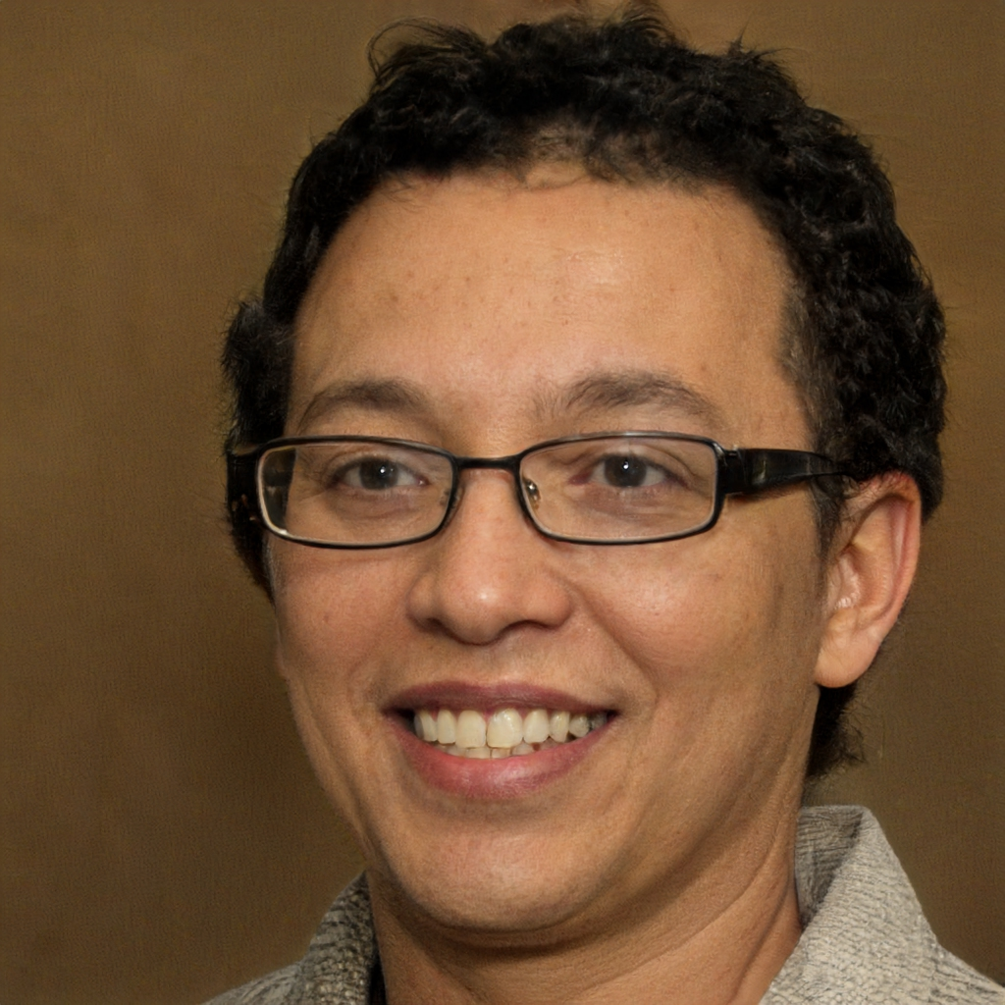
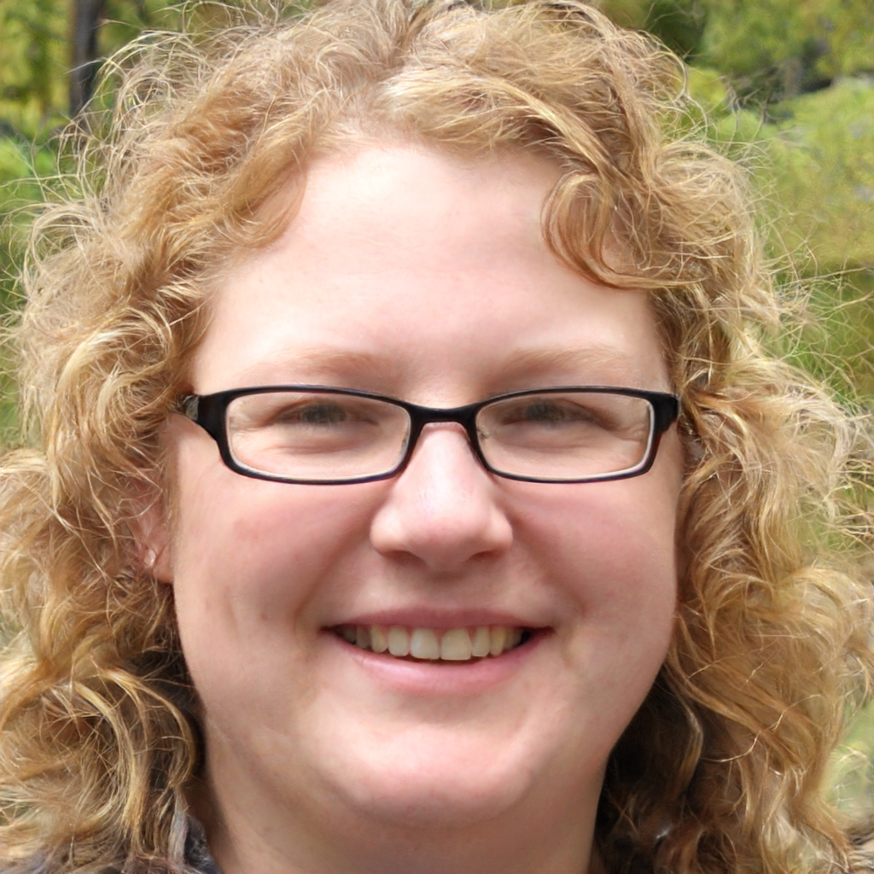
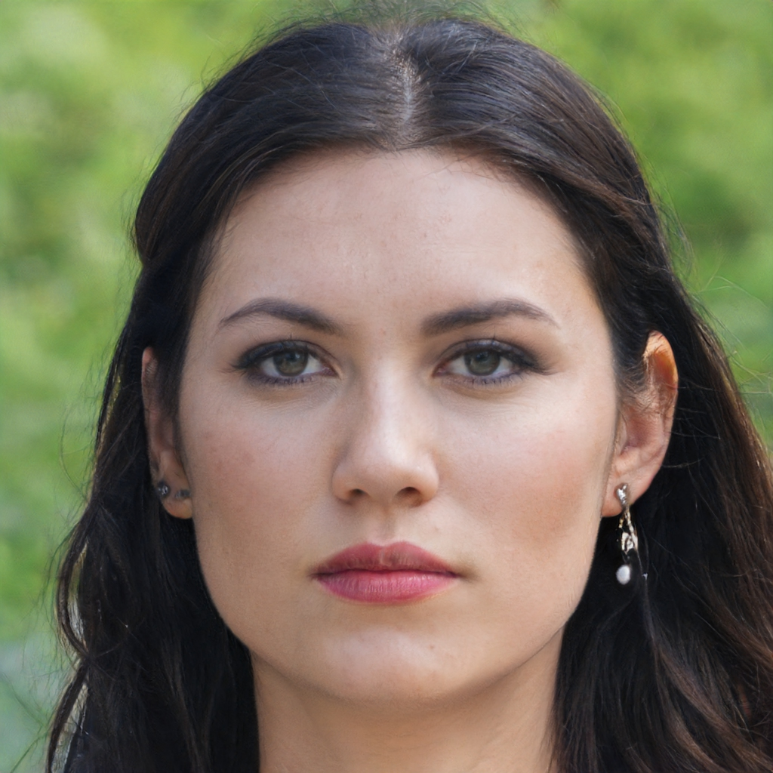
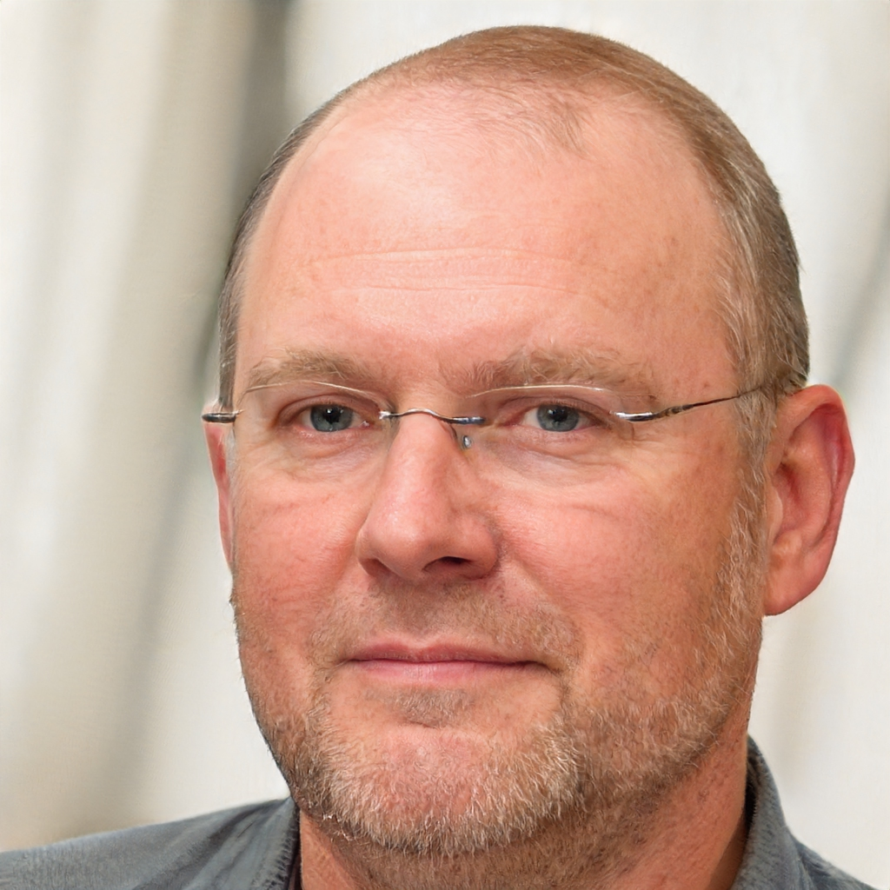
Follow-up level of Engagement
 | 1 CURIOUS | 2 PLAYERS | 3 SCOUTS |  |  | 4 CO HOSTS |  |  | 5. LEAD HOSTS |  |  | 6. CONTENT CREATORS |  |  | 7. GAME / CONTENT COMMUNITY BOOSTERS
Topic 1
Topic 2
Topic 3
Topic 4

Slide 192


Zoom on : Level 3 scout
I cannot spread the information myself, but I can arrange appointments
I help assess the potential value and promote new opportunities
Now I know how valuable the content can be !
I would like you to meet
New audience
Learning as a player (level 2)
Becoming a scout (level 3)
Finding opportunities

Slide 193
Zoom on : Level 3 scout
First Learning event
New audience and potential for new learning event
Players turn into scouts
New audience and potential for new learning event
New audience and potential for new learning event
New audience and potential for new learning event
New audience and potential for new learning event

Slide 194

Zoom on : Level 4 Co-host
I have promoted n lot and now I feel ready to spread, but with assistance
Promoting as a scout (level 3)
Becoming a Co-Host (level 4)
Train as a co-host (level 4) with a host (level 5)
Train as a host (level 5) with a former host as co-host (level 4)

Slide 195




Engage at the end of every event
Rappel des rôles, du potentiel d’évolution de chacun.e
Débriefing lié au rôle : Qui souhaite augmenter de niveau ? (+ prises d’engagements)
Les événements commencent et terminent par l’invitation à l’engagement. Cet engagement est facilité par les rôles #OSG.
Présentation
Transmission
Atelier
Meet-up
Contenu spécifique à la communauté
NIV 1 CURIEUX(-SE) : donne de l’attention
NIV 2 JOUEUR(-SE) : donne du temps
NIV 3 ECLAIREUR(-SE) : donne l’opportunité
NIV 4 CO-ANIMATEUR(-TRICE) : donne de la contribution
NIV 5 ANIMATEUR(-TRICE) : prend des responsabilités
NIV 6 CRÉATEUR(-TRICE) : créé des contenus
NIV 7 CONTENT COMMUNITY BOOSTER : développe la communauté
NIV 5 ANIMATEUR(-TRICE) : prend des responsabilités
NIV 6 CRÉATEUR(-TRICE) : créé des contenus
Début
Fin

Slide 196

Engage at the end of Every content
Début du contenu
Les contenus commencent et terminent par l’invitation à l’engagement.
Cet engagement est facilité par les rôles #OSG.
Rappel au début du contenu : vous aussi pouvez aussi contribuer à l’écriture / l’enregistrement / la production
NIV 1 CURIEUX(-SE) : donne de l’attention
NIV 2 JOUEUR(-SE) : donne du temps
NIV 3 ECLAIREUR(-SE) : donne l’opportunité
NIV 4 CO-ANIMATEUR(-TRICE) : donne de la contribution
NIV 5 ANIMATEUR(-TRICE) : prend des responsabilités
NIV 6 CRÉATEUR(-TRICE) : créé des contenus
NIV 7 CONTENT COMMUNITY BOOSTER : développe la communauté
Fin du contenu
Call-to-action : Vous aussi, vous pouvez produire du contenu !
NIV 5 ANIMATEUR(-TRICE) : prend des responsabilités
NIV 6 CRÉATEUR(-TRICE) : créé des contenus

Slide 197
Link-first Community Building in 7 steps

Slide 198
7 steps
Define Community Identity & Value
Define Community People Graph Target
Define Community Engagement Paths (User experience)
Set up Community Shared Calendar
Set up Community Content Strategy
Community Processes & Rituals
Set up Growth and continuous building habit

Slide 199
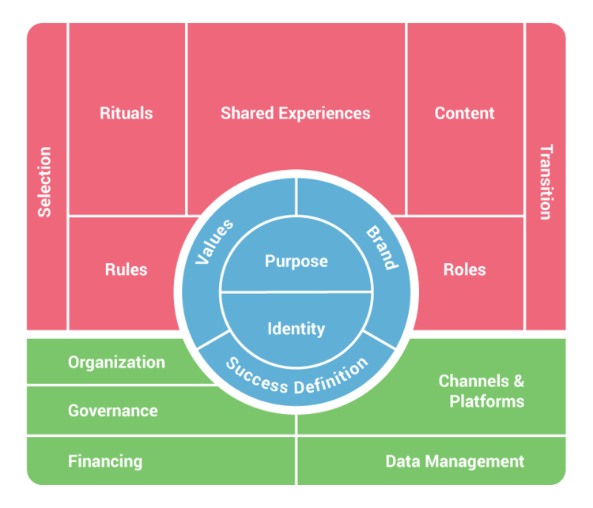
Step 1 : Define Community Identity & Value
Facilitates General Overview
Can be filled in Co-design workshop
Good for setting business objectives, defining and aligning sponsors
To be completed with more practical view
https://community-canvas.org/

Slide 200
Step 2A : Define Community People Graph Target
Choose Community architecture :
Facilitates growth or engagement strategy
Facilitates Expectations Management
Facilitates Operational Objectives Settings
Broadcast first
Ex : Online Fans community
Key strategy :
Efficient mass content
Key quality :
Content production quality
Order first
Ex : Religious Order
Key strategy :
Find and Hire Key people
Key quality :
Alignment
Link first
Ex : Business network
Key strategy :
Facilitate link building
Key quality :
Connectiveness Graph Knowledge
Focus First
Ex : Circle of experts
Key strategy :
Increase Local Value & Expertise
Key quality : Regularity

Slide 201
The specific case of “Link First” community

Slide 202
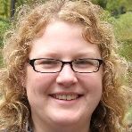
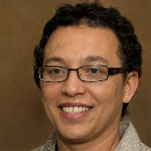
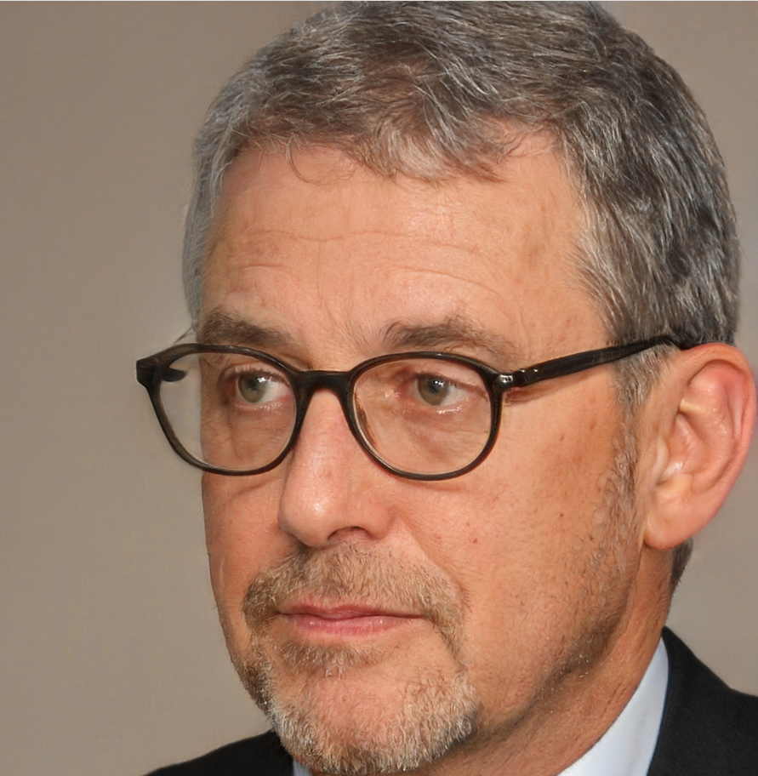

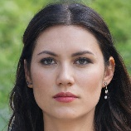
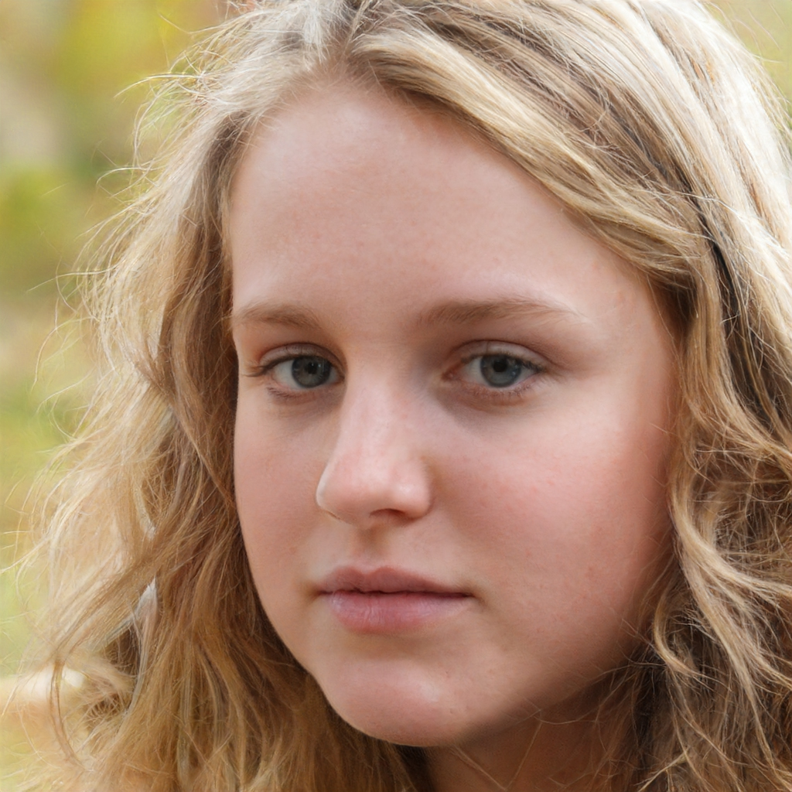
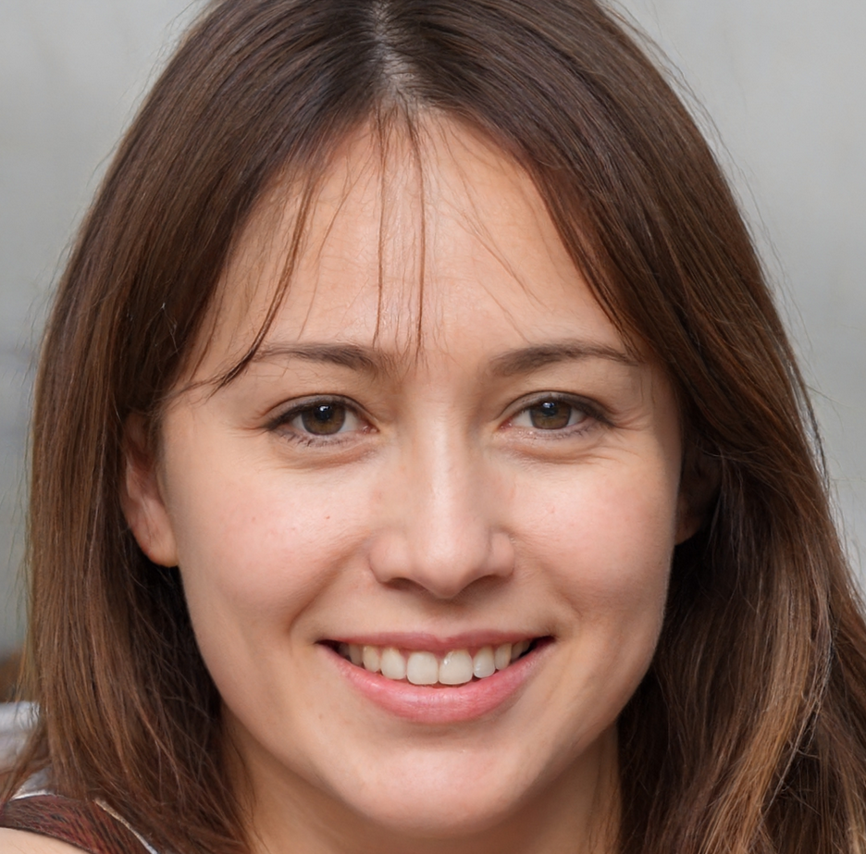
Step 2B : Identify Community People Graph
Makes identifying key people easier
Represents key links between people
Can be initiated in a Community Boosters Workshop
Better for organic growth consistency
Can be used as a basis for decision making and growth follow-up
Strategy : Try to reuse existing link, and if there is no existing link, set up new links

Slide 203
Step 3 : Define Community Engagement Path
Example : The #OpenSeriousPath
I’m interested
I try
I promote
I help in knowledge sharing
I share knowledge
I create content, variations
I boost members into upper levels
LEVEL 1 CURIOUS
LEVEL 2 PLAYERS
LEVEL 3 SCOUTS
LEVEL 4 CO-HOST
LEVEL 5 HOST
LEVEL 6 CREATOR
LEVEL 7 CONTENT COMMUNITY BOOSTER
Goal is to bring every member to their max engagement level

Slide 204

Step 4 : Set up Community Shared Calendar
Jan 5
Shows “Step by Step” Community Growth and Link Reinforcement
Makes the most of existing Community Link and Community Members
Sep 12
Dec 15
Oct 23

Slide 205
Step 5 : Set up community Content strategy
Newsletter – Mail- Push
Based on assumption : Key people will spread the key content if valuable
Content must be adapted to the graph according to preferences and habits
Key quality : Targeting
Meetups
Events
Push
Articles
MS Teams room
Pull

Slide 206
Step 6 : Community Processes and Rituals
Choose processes & rituals to
Boost & Follow-up People
Count
Share the counts
Increase the numbers
Boost & Follow-up of Content
Count
Share
Increase the numbers
Boost & Follow-up of Value
Count
Share
Increase the numbers
I’m interested
I try
I promote
I help in knowledge sharing
I share knowledge
I create content, variations
I boost members into upper levels
200
52
35
12
6
4
2
200
52
35
12
6
4
Implementations
Business opportunities
Business results
12
6

Slide 207
Step 7 : Set up growth and continuous improvement habits
Growth by Design
“Bring your friends” strategies
“It’s your turn to share” strategies
Automation (reduce workload of tasks) and processes (reduce workload of decisions)
Engagement by Design
“What’s your Next Level” strategy
“Become Active step by step” strategy
Continuous Improvement Loops
Retrospectives
Feedback walls

Slide 208
To finish

Slide 209
What topics can you fit in the #OSG
Workshops :
Easy to know if you are level 2,3,4,5,6..
Small enough
Concrete enough
Has borders
Has clear rules
Has clear outcomes
Easier to reproduce

Slide 210
Measuring Community Knowledge sharing Performance
3 Value Indicators
Shared knowledge must be valuable for the host organization of the Community
Overall satisfaction (ratings of quality of formats)
Overall utility (rating of content utility)
Results of Implementation
3 People Indicators
People indicators measure engagement, overall knowledge sharing skills
3 Content Indicators

Slide 211
Training for each level

Slide 212
Level 5 training : Content structure
Content :
As a Level 5, what you can put in your content to improve the knowledge sharing efficiency (in intro, inside, as a result)
Workshop preparation for Content preparation

